Slide 1
API-driven Cloud Native Solutions
Notes:
Hello everyone!

Slide 2
CC ZG506
Lecture No. 8

Slide 3
Contact Session wise Coverage
Session | Coverage
CS01 | API Basics (OpenAPI, REST, gRPC, GraphQL)
CS02 | API Basics + Cloud Native Application
CS03 | Cloud Native Application
CS04 | Introduction to Data Science & Machine Learning, DataOps & MLOps
CS05 | API driven Cloud-native Data Pipeline
CS06 | API-driven ML pipelines
CS07 | Tools review; Case Study
CS08 | Basic APIs for AI Applications – NLP, CV, Speech recognition
CS09 | Language Models (LLMs)
CS10 | RAG Models
CS11 | RAG Models
CS12 | Cloud Native Application Deployment
CS13 | IoT and Data Analytics
CS14 | APIs for IoT and Data Analytics
CS15 | Serverless Functions; Case study
CS16 | Course review and discussion
Basics
Data Science & ML
Cognitive AI
IoT

Slide 4
Agenda
AI and Cognitive Services
Part-A: Basic APIs for AI applications
Hugging Face APIs
Natural Language Processing APIs
Computer Vision APIs
Speech Recognition APIs
Case Study: API usage in AI Applications
Notes:
The slide presents an Agenda for a session or workshop titled "AI and Cognitive Services". It is structured into Part-A: Basic APIs for AI Applications and highlights the following key components:
Hugging Face APIs
Hugging Face provides a library and tools for state-of-the-art machine learning models, primarily in Natural Language Processing (NLP). It includes pre-trained models like Transformers.
Natural Language Processing (NLP) APIs
APIs for NLP include tools for sentiment analysis, text classification, language translation, summarization, and chatbot development (e.g., OpenAI GPT, Google Cloud NLP).
Computer Vision APIs
These APIs enable applications to analyze and understand visual data, such as image recognition, object detection, and facial recognition (e.g., Microsoft Azure Computer Vision, Google Cloud Vision).
Speech Recognition APIs
APIs that convert spoken language into text, enabling speech-to-text capabilities. These are commonly used in virtual assistants and transcription tools (e.g., Google Speech-to-Text, IBM Watson).
Case Study: API usage in AI Applications
A practical example or real-world use case demonstrating how the discussed APIs are integrated into AI applications.
The session is likely aimed at familiarizing participants with foundational APIs used in AI development and showcasing practical implementations.

Slide 5
AI and Cognitive Services

Slide 6
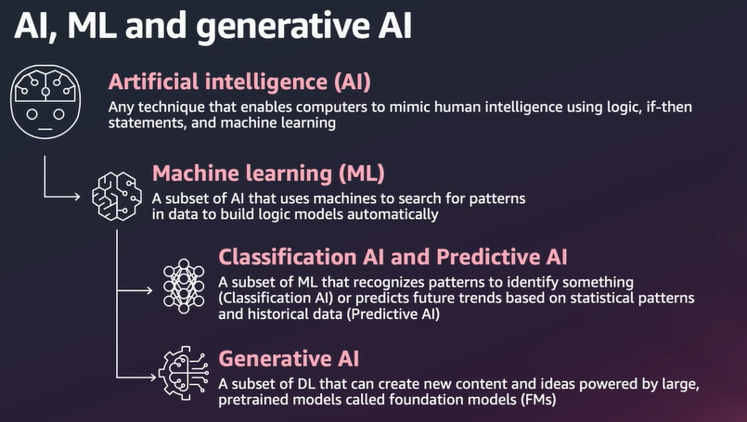
AI, ML and Generative AI
Ref: Adapted from 'AWS Innovate Conference, 2024', Presentation by Melwin Pais, Senior Solution Architect, AWS
Notes:
The slide explains AI, ML, and Generative AI concepts with a structured breakdown:
Artificial Intelligence (AI):
AI encompasses techniques that enable computers to mimic human intelligence.
It uses logic, if-then statements, and machine learning approaches.
Machine Learning (ML):
A subset of AI where machines analyze data to search for patterns and automatically build models.
ML is data-driven and enables systems to learn without being explicitly programmed.
Classification AI and Predictive AI:
Classification AI: Identifies patterns to recognize specific objects, labels, or categories.
Predictive AI: Analyzes historical and statistical data to predict trends or future outcomes.
Generative AI:
A subset of Deep Learning (DL).
It focuses on creating new content and ideas using large, pretrained models, also referred to as foundation models (FMs).
Generative AI can produce text, images, videos, and other creative outputs.
Key Takeaways:
The diagram highlights the hierarchical relationship: AI > ML > DL > Generative AI.
Generative AI is an advanced area within AI, specifically leveraging deep learning to generate new data.
The slide references AWS Innovate Conference 2024 and credits Melwin Pais, a Senior Solution Architect at AWS, further indicating a focus on industry-level AI advancements.

Slide 7
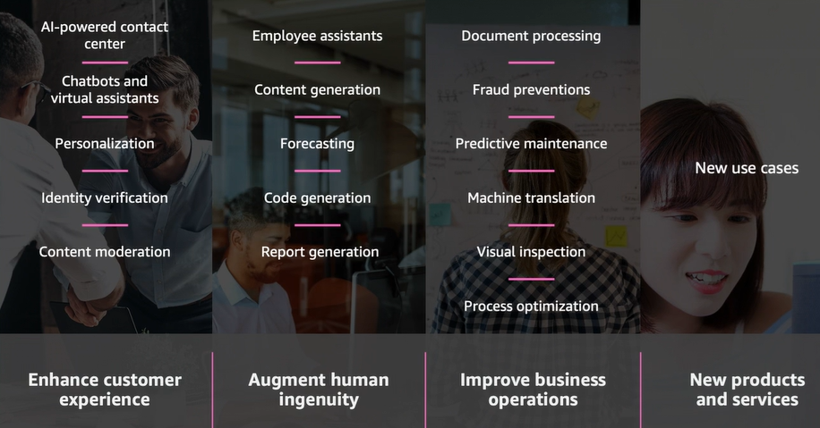
AI Use Cases
Ref: Adapted from 'AWS Innovate Conference, 2024', Presentation by Melwin Pais, Senior Solution Architect, AWS
Notes:
This slide highlights AI Use Cases across four key areas, showing how AI transforms various domains:
1. Enhance Customer Experience
AI-powered contact centers: Improving customer support using AI-driven solutions.
Chatbots and virtual assistants: Automating customer interactions for faster responses.
Personalization: Delivering customized user experiences.
Identity verification: Enhancing security through AI-based verification techniques.
Content moderation: Automating review and filtering of content for compliance.
2. Augment Human Ingenuity
Employee assistants: AI tools to support employees with routine tasks.
Content generation: Automating the creation of text, images, and other forms of content.
Forecasting: Predicting trends and outcomes based on data.
Code generation: Using AI to automate software development and coding tasks.
Report generation: Automating data reporting for analysis and insights.
3. Improve Business Operations
Document processing: Automating handling and analysis of documents.
Fraud prevention: Identifying and preventing fraudulent activities using AI.
Predictive maintenance: Forecasting equipment failures to optimize maintenance schedules.
Machine translation: Enabling language translations through AI tools.
Visual inspection: Enhancing quality control processes through AI-based vision systems.
Process optimization: Streamlining business operations using AI insights.
4. New Products and Services
Represents the development of new use cases where AI drives innovation, creating products and services that were previously unimaginable.
Summary:
This slide emphasizes how AI applications are strategically divided into enhancing customer experience, augmenting human ingenuity, improving business operations, and enabling new products/services. The examples provided demonstrate AI's transformative impact across industries.
The source is again AWS Innovate Conference 2024, presented by Melwin Pais, Senior Solution Architect at AWS.

Slide 8
Three Generations of Machine Learning
Gen 1: Basic Machine Learning
Effort: Create Labeled datasets, Train Models using basic ML algorithms, Measure Performance
Gen 2: Deep Learning [based on Artificial Neural Networks]
[Emergence of Big Data]
Effort: Re-Train Models using DL algorithms and measure performance
Gen 3: Transfer Learning / Transformers
[Pre-trained models / Fine-tuned models available]
Effort: Use APIs in various applications on a pay-per-use basis. No model training required
Notes:
This slide outlines the Three Generations of Machine Learning, showing the evolution of ML techniques, effort involved, and the emergence of advanced methods:
Gen 1: Basic Machine Learning
Key Characteristics:
Focuses on creating labeled datasets and training models using basic ML algorithms.
Performance is manually measured and optimized.
Effort: High effort required for data preparation, feature engineering, and model training.
Example: Traditional algorithms like linear regression, decision trees, and support vector machines.
Gen 2: Deep Learning (DL)
Key Characteristics:
Based on Artificial Neural Networks (ANNs), enabling significant progress in AI.
Driven by the emergence of big data and availability of computational power (GPUs).
Effort: Re-training models using deep learning algorithms to improve performance.
Example: CNNs for computer vision, RNNs for sequence data, and advancements in large-scale models.
Gen 3: Transfer Learning / Transformers
Key Characteristics:
Utilizes pre-trained models that can be fine-tuned for specific applications.
Transformers (like GPT and BERT) enable rapid development of applications without extensive training.
Effort: Minimal effort compared to earlier generations. APIs and pre-trained models are used on a pay-per-use basis, eliminating the need for model training.
Example: Hugging Face APIs, OpenAI GPT models, Google BERT.
Summary
Gen 1: Focused on traditional algorithms and labeled datasets.
Gen 2: Enabled by big data and deep learning advancements.
Gen 3: Reduced effort by leveraging pre-trained models and APIs for real-world applications.
This slide effectively illustrates how machine learning has evolved to streamline development while increasing performance and accessibility.

Slide 9
Pre-Trained vs Fine-Tuned Models
Training data
Pre-trained models are trained on large datasets, while fine-tuned models are trained on specific examples.
Purpose
Pre-trained models are general-purpose base models, while fine-tuned models are adapted for specific tasks or domains.
Efficiency
Pre-training is computationally intensive, while fine-tuning is more efficient because it builds on the pre-trained model.
Notes:
This slide contrasts Pre-Trained Models and Fine-Tuned Models based on three key criteria:
1. Training Data
Pre-trained models:
Trained on large, diverse datasets that cover broad use cases and general patterns.
Example: GPT, BERT, ResNet, which learn general features from massive data sources.
Fine-tuned models:
Trained on specific examples or smaller datasets tailored to a particular task, domain, or use case.
Example: Fine-tuning GPT for customer support or medical text classification.
2. Purpose
Pre-trained models:
Serve as general-purpose base models that can be used for multiple applications.
They act as starting points for more specialized tasks.
Fine-tuned models:
Adapted to specific tasks or domains by adjusting the pre-trained model on targeted data.
This ensures higher performance for niche tasks.
3. Efficiency
Pre-training:
Computationally intensive and time-consuming, as it involves processing massive datasets from scratch.
Requires significant resources like GPUs or TPUs.
Fine-tuning:
More efficient since it builds on the pre-trained model’s knowledge, reducing computational effort.
Fine-tuning adapts the model quickly for new tasks without re-training from scratch.
Summary
Pre-trained models provide broad, foundational learning.
Fine-tuned models efficiently tailor these foundations for specific tasks, balancing performance and resource usage.
This approach is widely used in AI to achieve state-of-the-art results with reduced effort and computation.

Slide 10
Pre-Trained vs Fine-Tuned Models
Performance
Fine-tuning can improve a model's performance on specific tasks, and can often outperform models trained from scratch.
Transfer learning
Fine-tuning allows models to apply knowledge gained from one task to another, potentially unrelated task.
Interpretability
Fine-tuning can make models more interpretable, which can help with debugging and understanding the model's behavior.
Notes:
This slide further elaborates on the differences between Pre-Trained Models and Fine-Tuned Models, focusing on three specific factors:
1. Performance
Fine-tuning can improve a model's performance on specialized tasks.
In many cases, fine-tuned models outperform models trained from scratch due to the pre-trained knowledge they leverage.
Example: Fine-tuning GPT for domain-specific tasks like legal document analysis.
2. Transfer Learning
Fine-tuning utilizes transfer learning, where a model applies knowledge gained from one task to another, even if the tasks are unrelated.
This is a significant advantage because the model starts with a solid understanding from its pre-training phase.
Example: A model trained on general language data (like BERT) can be fine-tuned for sentiment analysis or medical text classification.
3. Interpretability
Fine-tuning can make models more interpretable, which is crucial for debugging and understanding the model’s behavior.
This improved interpretability helps practitioners identify and analyze performance bottlenecks or explain the model’s decision-making process.
Summary
Fine-tuned models offer better performance on targeted tasks.
Transfer learning enables the efficient reuse of pre-trained models for new problems.
Fine-tuning enhances interpretability, facilitating a better understanding of model behavior and decisions.
This highlights the value of combining pre-trained models with fine-tuning for practical AI applications.

Slide 11
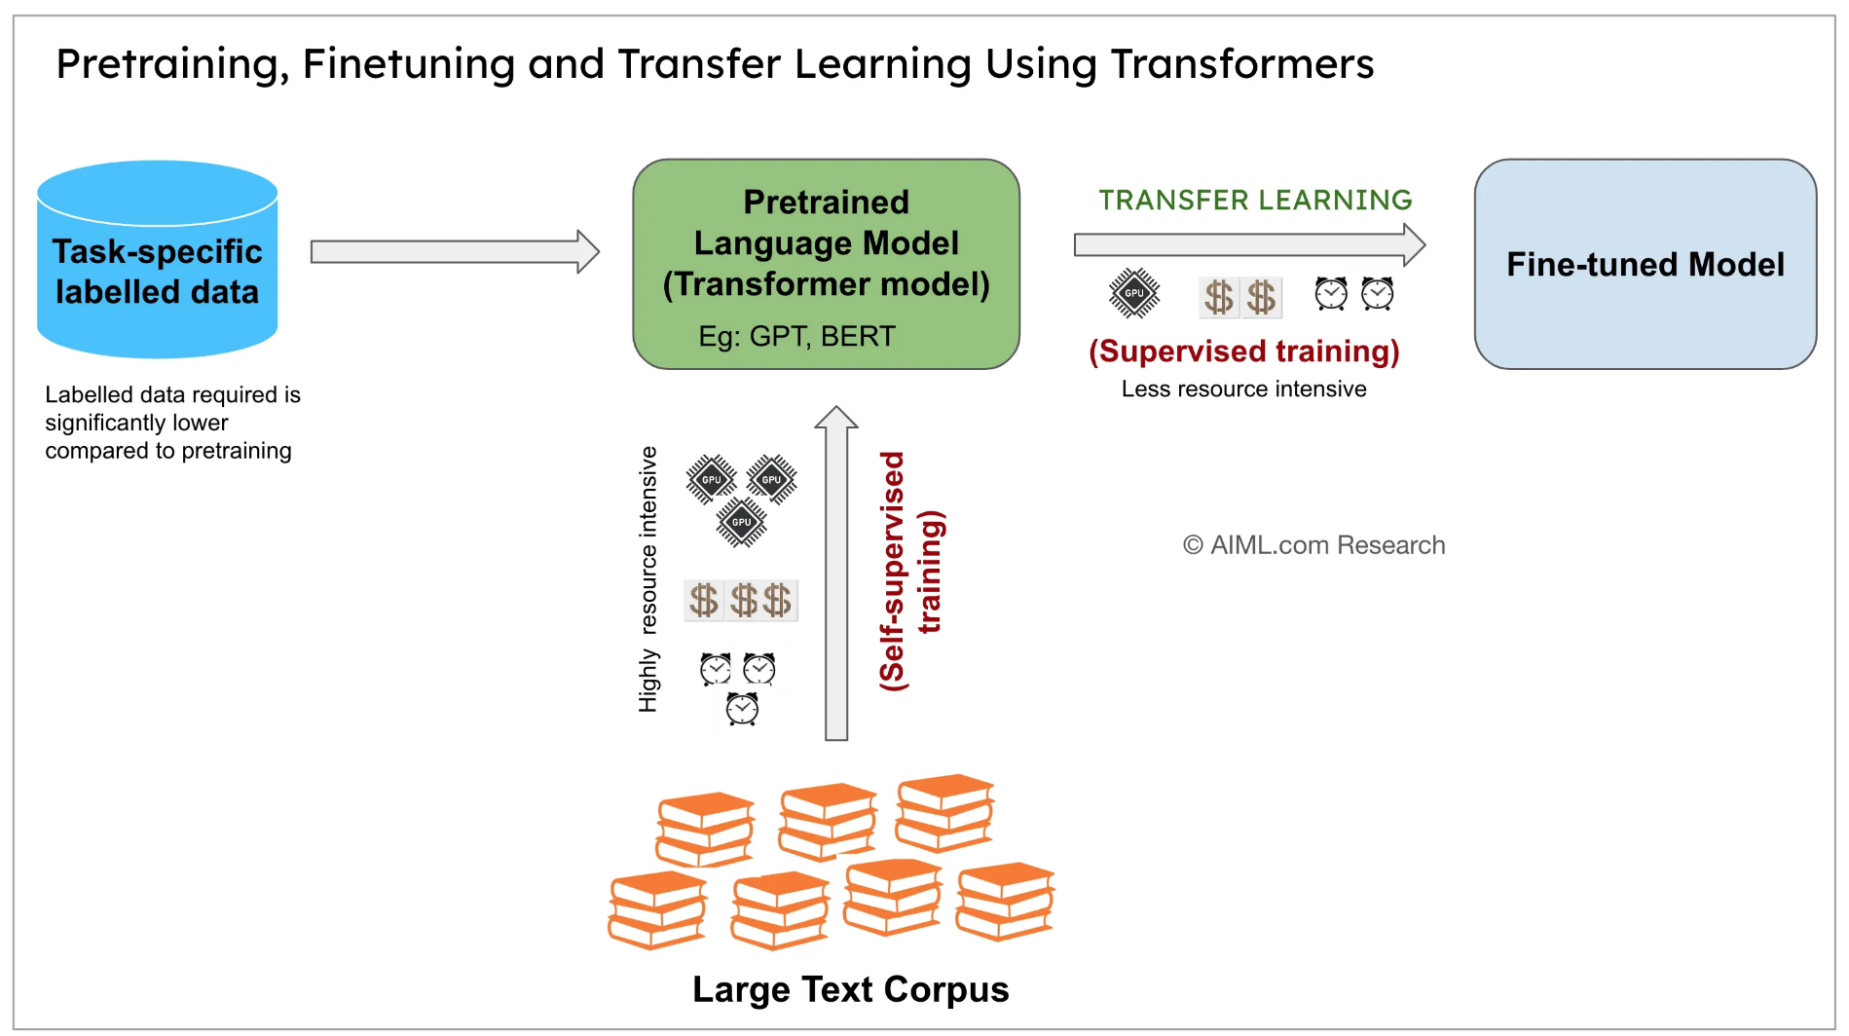
Pre-Trained vs Fine-Tuned Models
Notes:
This slide visually explains the relationship between Pre-trained Models, Fine-Tuned Models, and the use of Transfer Learning with Transformers like GPT and BERT.
Workflow Overview
Pretraining Phase (Resource-Intensive):
A large text corpus is used for pretraining.
Models undergo self-supervised training (e.g., predicting masked words in a sentence) to learn general language patterns.
This phase is highly resource-intensive and requires significant computational power, time, and data.
Pretrained Language Model (Transformer Model):
Examples include GPT and BERT, which serve as general-purpose base models.
These models have already captured broad language knowledge.
Fine-Tuning Phase (Resource-Efficient):
Task-specific labeled data is used to fine-tune the pretrained model for a specific application.
Fine-tuning involves supervised training, which is less resource-intensive compared to pretraining.
Significantly less labeled data is required during fine-tuning.
Resulting Fine-Tuned Model:
The final model is specialized for a particular task, such as sentiment analysis, text classification, or language translation.
Key Insights:
Pretraining:
Expensive and requires extensive resources.
Produces generalized models (like BERT/GPT).
Fine-tuning:
Builds on pretrained knowledge using minimal data.
Efficient and specialized for specific tasks.
Transfer Learning:
Enables reuse of pretrained models for diverse applications with significantly reduced effort.
Summary
This approach highlights the efficiency of modern AI workflows: leverage powerful pretrained Transformer models and adapt them to domain-specific tasks using fine-tuning with task-specific labeled data.

Slide 12
AI-based Cognitive Services
Cognition – “Mental action or process of acquiring knowledge and understanding through thought, experience, and the senses”
Cloud-based cognitive services are a set of AI-powered APIs and tools provided by cloud platforms (such as Microsoft Azure, AWS, or Google Cloud) that enable developers to easily integrate AI functionalities into their applications without needing in-depth knowledge of AI or machine learning.
These services use cloud infrastructure to offer scalable, ready-to-use models and algorithms for tasks involving human-like cognitive abilities.
Notes:
This slide explains AI-based Cognitive Services and their role in modern applications:
Definition of Cognition
Cognition is described as the mental process of acquiring knowledge and understanding through thought, experience, and senses.
Cloud-Based Cognitive Services
AI-Powered APIs and Tools:
Cloud platforms like Microsoft Azure, AWS, and Google Cloud offer AI-powered cognitive services.
These services provide ready-to-use APIs for developers to integrate AI functionalities without needing deep expertise in AI or machine learning.
Scalability and Usability:
Cognitive services leverage cloud infrastructure to offer scalable solutions.
These services are ready-to-use and can perform tasks requiring human-like cognitive abilities, such as:
Natural Language Processing (NLP)
Computer Vision
Speech Recognition
Sentiment Analysis
Key Takeaways
Accessibility: Developers can easily integrate cognitive services into applications without extensive AI/ML knowledge.
Cloud-Powered: The cloud provides the scalability required for large-scale tasks.
Human-Like Abilities: Cognitive services replicate tasks like understanding text, images, and speech.
This slide highlights how cloud-based cognitive services are democratizing AI by providing tools that simplify complex AI tasks, enabling broad adoption across industries.

Slide 13
Cognitive Services
Ex: Azure AI Services
Set of cloud-based APIs that you can use in AI applications and data flows.
It provides pretrained models that are ready to use in your applications, requiring no data and no model training on your part.
The services are developed by the Microsoft AI and Research team and expose the latest deep learning algorithms.
They're consumed over HTTP REST interfaces.
In addition, SDKs are available for many common application development frameworks.
https://learn.microsoft.com/en-us/azure/architecture/data-guide/technology-choices/cognitive-services
Notes:
This slide focuses on Cognitive Services with a specific example of Azure AI Services. It highlights the ease and capabilities provided by cloud-based AI services:
Key Features of Cognitive Services (Azure AI Services)
Cloud-Based APIs
A collection of cloud-based APIs that can be directly integrated into AI applications and data flows.
Pretrained Models
Provides ready-to-use pretrained models that require:
No additional data
No model training
These models can be utilized instantly to perform tasks like NLP, speech recognition, computer vision, etc.
State-of-the-Art AI Development
Services are developed by the Microsoft AI and Research team.
Incorporates latest deep learning algorithms for high accuracy and efficiency.
Ease of Use
These services are consumed via HTTP REST interfaces, making them easily accessible for integration into applications.
SDKs (Software Development Kits) are also provided for seamless use in various application development frameworks.
Advantages
No Training Required: Pretrained models eliminate the need for manual model building and training.
Developer-Friendly: Ready-to-use APIs and SDKs simplify integration.
Scalability: Cloud infrastructure ensures scalability for large-scale applications.
Reference Link
The slide includes a helpful resource for further reading: Microsoft Azure Cognitive Services Guide
Summary
Azure AI Services demonstrate how cloud-based cognitive services reduce complexity and enable developers to integrate advanced AI functionalities into applications with minimal effort and resources.

Slide 14
Benefits
Minimal development effort for state-of-the-art AI services.
Use predefined algorithms or create custom algorithms on top of pre-built libraries.
Easy integration into apps via HTTP REST interfaces.
Developers and data scientists of all skill levels can easily add AI capabilities to apps.
https://learn.microsoft.com/en-us/azure/architecture/data-guide/technology-choices/cognitive-services
Notes:
This slide highlights the Benefits of using AI-based cognitive services, emphasizing their accessibility, flexibility, and ease of integration:
Key Benefits
Minimal Development Effort
Developers can leverage state-of-the-art AI services with minimal effort.
Eliminates the need for building complex AI models from scratch.
Predefined and Custom Algorithms
Users can either:
Utilize predefined algorithms provided by cognitive services.
Build custom algorithms on top of pre-built libraries for more tailored solutions.
Easy Integration
Cognitive services can be seamlessly integrated into applications via HTTP REST interfaces, making them platform-independent and easy to use.
Accessible to All Skill Levels
Both developers and data scientists, regardless of skill level, can effortlessly add AI capabilities to their applications.
This democratizes AI by making advanced functionalities accessible.
Summary
The slide highlights how cognitive services reduce the barriers to adopting AI:
Minimal effort for development.
Ready-to-use tools with flexibility for customization.
Easy integration via standard REST APIs.
Suitable for developers of all experience levels.
The resource link to Microsoft Azure Cognitive Services is provided for further exploration.

Slide 15
Types of Services
Service | Description
Language | Services that provide Natural Language Processing (NLP) features for understanding and analyzing text.
Speech | Services that provide speech capabilities like speech-to-text, text-to-speech, speech translation, and speaker recognition
Computer Vision | Services that provide image and video recognition capabilities
Decision Services | Services that provide NLP features to produce recommendations for informed and efficient decision-making
Azure OpenAI Service | Service provides REST API access to powerful OpenAI language models.
https://learn.microsoft.com/en-us/azure/architecture/data-guide/technology-choices/cognitive-services
Notes:
The slide, titled "Types of Services", provides an overview of various cognitive services offered by cloud platforms, specifically Microsoft Azure, and organizes them into categories based on their functionality. Below is a detailed explanation of the slide's contents:
1. Service Categories
The slide lists five major service types in a tabular format, where each type represents a distinct set of features. These are essential building blocks for creating intelligent applications that leverage AI and machine learning.
2. Categories Explained
Language
Description: Focuses on Natural Language Processing (NLP), enabling systems to understand, analyze, and manipulate human language in text form.
Use Cases:
Text analytics: Extracting insights like sentiment, key phrases, or entities from text.
Language translation: Translating content between languages in real-time.
Document summarization: Condensing large text data into concise summaries.
Speech
Description: Provides features for interacting with and processing spoken language. This includes:
Speech-to-text: Converting voice input into written text.
Text-to-speech: Synthesizing spoken output from text input.
Speaker recognition: Identifying or verifying speakers from their voice.
Speech translation: Translating spoken language from one language to another.
Applications:
Voice-controlled applications like smart assistants (e.g., Alexa, Siri).
Call center automation with voice bots.
Accessibility tools for the visually impaired.
Computer Vision
Description: Services designed to interpret, process, and analyze visual content, such as images and videos.
Capabilities:
Image classification: Identifying objects, people, or scenes in images.
Object detection: Locating and tracking objects in images/videos.
OCR (Optical Character Recognition): Extracting text from scanned documents or photos.
Applications:
Facial recognition for security systems.
Product identification in retail.
Medical image analysis (e.g., X-rays or MRIs).
Decision Services
Description: Uses AI models and NLP to assist with decision-making tasks by analyzing data and providing actionable recommendations.
Examples:
Personalization: Tailoring user experiences based on behavior (e.g., Netflix recommendations).
Fraud detection: Identifying anomalies in transactions or data.
Business forecasting: Assisting in decision-making with predictive analytics.
Value:
Helps businesses make data-driven and efficient decisions.
Improves automation in areas like e-commerce and finance.
Azure OpenAI Service
Description: Provides access to state-of-the-art OpenAI models, such as GPT (Generative Pre-trained Transformer). This is delivered via REST APIs to enable integration of advanced AI features.
Capabilities:
Text generation and completion.
Conversational AI (chatbots and virtual assistants).
Semantic search for better information retrieval.
Applications:
Content creation for marketing or documentation.
Intelligent customer support bots.
Automating workflows in businesses.
3. Conclusion
The table categorizes and summarizes the functionalities of different cognitive services, providing an overview of how businesses and developers can integrate these tools into applications. It highlights the role of AI in enabling automation, enhancing user experiences, and solving complex problems efficiently.
The provided URL links to more information about Azure’s cognitive services for additional learning or technical details.

Slide 16
HuggingFace
Notes:
This slide introduces Hugging Face, a prominent organization and platform in the field of natural language processing (NLP) and machine learning. Here’s a detailed explanation of what "Hugging Face" represents and its significance:
1. About Hugging Face
Hugging Face is an open-source platform and community known for its contributions to:
Transformers Library: A widely used library for state-of-the-art NLP models like BERT, GPT, and RoBERTa.
Machine Learning: Offering tools for text processing, computer vision, and multimodal applications.
Developer Community: A hub for developers to share models, datasets, and machine learning resources.
2. Key Features and Contributions
Transformers Library
Provides pre-trained models for tasks such as text classification, summarization, question answering, and translation.
Supports integration with deep learning frameworks like TensorFlow and PyTorch.
Hugging Face Hub
A repository for sharing and accessing pre-trained models, datasets, and scripts.
Enables seamless collaboration and reproducibility in machine learning research.
Applications Beyond NLP
Hugging Face has expanded its scope to include vision and audio tasks, supporting a broad range of applications in AI.
3. Importance in AI and NLP
Hugging Face simplifies the adoption of complex NLP models by providing ready-to-use implementations and tools.
Encourages democratization of AI by making cutting-edge technologies accessible to researchers, developers, and enterprises.
4. Applications in the Real World
Chatbots: Building conversational agents.
Content Moderation: Analyzing and filtering harmful or inappropriate content.
Sentiment Analysis: Understanding user feedback in e-commerce and social media.
Healthcare: Extracting insights from medical records and literature.

Slide 17
Kaggle vs HuggingFace
Kaggle is a popular dataset store for Generation 1 ML and Generation 2 DL
URL - https://www.kaggle.com/
HuggingFace is a popular dataset and model store for Generation 3 Transformers
URL - https://huggingface.co/
Notes:
This slide compares Kaggle and Hugging Face, two prominent platforms in the machine learning and AI ecosystem, highlighting their specific focus and utility.
1. Key Comparison
Kaggle
Purpose:
A platform designed as a hub for datasets and competitions in Generation 1 Machine Learning (ML) and Generation 2 Deep Learning (DL).
Primarily used for classical ML tasks (e.g., regression, classification) and initial DL tasks with frameworks like TensorFlow and PyTorch.
Features:
A vast repository of datasets for various ML and DL projects.
Competitions for data scientists to solve challenges and collaborate with others.
Community-driven sharing of notebooks, code, and ideas.
URL: www.kaggle.com
Hugging Face
Purpose:
A platform designed as a hub for datasets and pre-trained models for Generation 3 Transformers.
Focuses on state-of-the-art Natural Language Processing (NLP) and other advanced AI tasks like computer vision and speech processing.
Features:
Provides pre-trained models (e.g., BERT, GPT, RoBERTa) and fine-tuning tools for modern AI tasks.
A dataset library integrated with their models to streamline AI development.
Active community sharing models, datasets, and research.
URL: huggingface.co
2. Generational Focus
Kaggle: Focuses on early generations of ML/DL, supporting researchers and practitioners working on foundational algorithms and techniques.
Hugging Face: Aligns with the latest trends in AI, such as transformers and generative AI, emphasizing scalable and pre-trained model usage.
3. Key Takeaway
Both platforms are critical in their respective domains:
Use Kaggle for dataset exploration, classical ML, and competitive learning.
Use Hugging Face for deploying cutting-edge AI models and leveraging advanced NLP tools.

Slide 18
HuggingFace
HuggingFace Hub is a open source platform for hosting:
Git-based code repositories, including discussions and pull requests for projects.
Models, also with Git-based version control
Datasets, mainly in text, images, and audio
Notes:
This slide provides an overview of the Hugging Face Hub, a collaborative open-source platform for hosting and managing machine learning assets like models, datasets, and code repositories. Below is a detailed explanation of the contents:
1. About Hugging Face Hub
The Hugging Face Hub is a Git-based platform designed to support:
Collaboration in the machine learning community.
Version control and management of ML assets.
Easy sharing and deployment of models, datasets, and projects.
2. Key Features
Git-based Code Repositories
Supports collaborative development similar to GitHub.
Includes:
Discussions: Enables users to engage in conversations about projects, issues, or improvements.
Pull Requests: Facilitates collaborative development by allowing contributions from others while maintaining version control.
Models with Git-based Version Control
Models hosted on the Hugging Face Hub are version-controlled using Git.
This feature allows:
Tracking changes in the model's configuration or parameters over time.
Reverting to previous versions if needed.
Collaboration on fine-tuning and improvement of models.
Examples:
State-of-the-art transformer models like BERT, GPT, RoBERTa, and more.
Datasets
Hosts a wide range of datasets in formats optimized for machine learning tasks.
Categories:
Text: For natural language processing tasks (e.g., translation, summarization).
Images: For computer vision tasks (e.g., classification, object detection).
Audio: For speech-related tasks (e.g., speech recognition, audio classification).
3. Significance
Simplifies collaboration by integrating familiar Git workflows into the ML ecosystem.
Centralized access to pre-trained models and datasets accelerates experimentation and deployment.
Promotes reproducibility and openness in machine learning research.
4. Applications
Researchers can host and version their models and datasets while collaborating with peers.
Developers can access pre-trained models and fine-tune them for specific tasks.
Organizations can streamline the deployment of AI models across projects.

Slide 19
HuggingFace APIs
Hugging Face APIs are cloud-based cognitive services, particularly in the areas of NLP, CV and Speech recognition.
Hugging Face provides a variety of pre-trained models and APIs that developers can use to build intelligent applications without needing to train models from scratch
Website - https://huggingface.co/
Notes:
This slide focuses on Hugging Face APIs, which are cloud-based services designed to simplify the integration of advanced AI capabilities into applications. Here is an explanation of its contents:
1. Overview of Hugging Face APIs
Definition: Hugging Face APIs are cloud-based cognitive services providing pre-built solutions for common AI tasks.
Focus Areas:
Natural Language Processing (NLP): Tasks like text summarization, translation, and sentiment analysis.
Computer Vision (CV): Image recognition, classification, and visual data processing.
Speech Recognition: Converting spoken language into text or synthesizing speech from text.
2. Features
Pre-trained Models:
Hugging Face APIs give access to a library of pre-trained models such as GPT, BERT, and more.
These models are optimized for real-world applications, saving developers the effort of training models from scratch.
Ease of Integration:
Developers can directly call these APIs using RESTful endpoints to integrate capabilities like text classification, translation, or image processing into their applications.
No Need for Training:
With pre-trained models, developers can focus on fine-tuning for specific use cases rather than starting from raw data and training a model.
3. Benefits
Faster Development:
Using pre-built APIs accelerates the development of AI-powered applications.
Cost-effective:
Reduces infrastructure and resource costs as models are hosted in the cloud.
Scalable:
Cloud-based infrastructure allows scaling as per demand.
4. Applications
NLP:
Chatbots, text summarization, language translation.
Computer Vision:
Image-based search, content moderation, facial recognition.
Speech:
Voice assistants, automated transcription, text-to-speech systems.
5. Website
The slide includes the link to Hugging Face's official website: https://huggingface.co/, which provides more information about APIs, models, datasets, and documentation.
Key Takeaway
Hugging Face APIs offer an efficient and accessible way to integrate cutting-edge AI technologies into applications, catering to various domains like NLP, computer vision, and speech processing. These services eliminate the need for extensive training processes, enabling faster innovation.

Slide 20
HuggingFace Key Terminologies
Task
Tasks refer to the specific machine learning or AI problems that you want to solve using Hugging Face models.
Each task represents a different type of problem, often tied to a particular application of machine learning or NLP.
Common tasks in Hugging Face:
Text Classification: Categorizing text into predefined categories (e.g., sentiment analysis, spam detection).
Named Entity Recognition (NER): Identifying and classifying entities (such as people, locations, organizations) in text.
Notes:
This slide explains the key terminologies related to Hugging Face, specifically focusing on the concept of Tasks and examples of common tasks supported by Hugging Face models. Here’s a detailed explanation:
1. Task
Definition:
In Hugging Face, a task refers to a specific machine learning or AI problem that a user aims to solve using pre-trained models or custom fine-tuned models.
Each task is tied to a particular application of machine learning, such as NLP, computer vision, or speech processing.
Significance:
Tasks define the type of input (text, images, or audio) and the desired output (e.g., categories, entities, or translations).
They help developers quickly identify the right model to use for solving their problem.
2. Common Tasks in Hugging Face
Hugging Face supports a wide range of tasks, and the slide lists two prominent ones:
Text Classification
Purpose: To categorize text into predefined categories.
Examples:
Sentiment Analysis: Determining the sentiment (positive, negative, or neutral) of a piece of text.
Spam Detection: Classifying emails or messages as spam or non-spam.
Topic Classification: Assigning text to topics like sports, politics, or entertainment.
Named Entity Recognition (NER)
Purpose: To identify and classify key entities in text.
Examples:
People: Extracting names like "John Smith."
Locations: Identifying places such as "New York" or "Paris."
Organizations: Detecting entities like "Google" or "United Nations."
3. Other Popular Tasks (Not Listed but Relevant)
If you'd like to go beyond this slide, here are additional tasks commonly handled by Hugging Face models:
Text Summarization: Creating concise summaries of long texts.
Machine Translation: Translating text from one language to another.
Question Answering: Finding answers to questions based on input context.
Text Generation: Generating coherent and context-aware text (e.g., using GPT models).
4. Practical Applications
Business: Customer sentiment analysis, feedback categorization, and spam filtering.
Healthcare: Extracting patient details from medical records.
Education: Automated grading of student responses or topic identification in essays.
Key Takeaway
Tasks are fundamental to using Hugging Face models effectively. They serve as a blueprint for determining which model to choose and how to structure your input and output. Hugging Face simplifies task implementation by providing pre-trained models optimized for these problems.

Slide 21
Task
Common Tasks
Text Generation: Generating text, such as autocompleting or generating a paragraph from a prompt (e.g., using GPT models).
Machine Translation: Translating text from one language to another.
Question Answering: Answering a question based on a given passage or context (e.g., SQuAD-style tasks).
Summarization: Creating a shorter version of a longer text while preserving the core meaning.
Image Classification: Classifying images into predefined categories (using models trained on images).
Speech Recognition: Converting spoken language into written text.
Object Detection: Identifying objects within an image.
Hugging Face provides an extensive list of pre-built models tailored to each of these tasks.
Notes:
This slide elaborates on various common tasks that can be accomplished using Hugging Face models and APIs. It highlights the diverse applications of Hugging Face in natural language processing (NLP), computer vision (CV), and speech recognition. Below is a detailed explanation of the tasks listed:
1. Text Generation
Definition: Automatically generating text based on a given input or prompt.
Examples:
Autocompleting sentences or paragraphs.
Generating creative content like stories or poetry.
Chatbots and conversational agents.
Models Used: GPT (Generative Pre-trained Transformers), such as GPT-2 and GPT-3.
2. Machine Translation
Definition: Translating text from one language to another.
Examples:
Translating English text to French, Spanish, or other languages.
Building multilingual chat applications.
Models Used: MarianMT, mBART, and others designed for multilingual tasks.
3. Question Answering
Definition: Extracting or generating answers to questions based on a given context or passage.
Examples:
Answering questions about a document or web page (e.g., FAQs).
Open-domain question answering like SQuAD (Stanford Question Answering Dataset).
Models Used: BERT, RoBERTa, DistilBERT fine-tuned for question answering.
4. Summarization
Definition: Creating concise summaries of longer texts while preserving the core meaning.
Examples:
Summarizing news articles or research papers.
Generating meeting or lecture notes automatically.
Models Used: BART, T5 (Text-to-Text Transfer Transformer).
5. Image Classification
Definition: Classifying images into predefined categories.
Examples:
Identifying objects in images (e.g., cat, dog, car).
Recognizing medical conditions from X-ray images.
Models Used: Vision transformers (ViT), ResNet.
6. Speech Recognition
Definition: Converting spoken language into written text.
Examples:
Transcribing audio recordings or live speech.
Enabling voice-to-text functionality in mobile applications.
Models Used: Whisper, Wav2Vec.
7. Object Detection
Definition: Identifying and locating specific objects within an image.
Examples:
Detecting vehicles and pedestrians for autonomous driving.
Recognizing products on retail shelves.
Models Used: DETR (DEtection TRansformer), YOLO (You Only Look Once).
8. Key Takeaway
Hugging Face provides an extensive library of pre-built models tailored for each of these tasks, allowing developers to quickly adopt state-of-the-art AI solutions without starting from scratch.
These models can be easily fine-tuned for specific use cases, making them versatile across industries.

Slide 22
Models
Models in Hugging Face refer to the machine learning models that are pre-trained to solve specific tasks.
These models can be either:
Pre-trained: Already trained on large datasets for common tasks (e.g., language modeling, text classification, translation).
Fine-tuned: Adapted from a pre-trained model to a more specific task using a smaller, domain-specific dataset.
Notes:
This slide focuses on models in Hugging Face, explaining their types and roles in solving machine learning tasks. Here’s a detailed explanation of the slide’s content:
1. Definition of Models in Hugging Face
Models refer to machine learning algorithms that are pre-trained or fine-tuned to solve specific AI tasks such as text classification, translation, question answering, and more.
Hugging Face provides a large repository of pre-trained models for easy and quick use in various applications.
2. Types of Models
1. Pre-trained Models
Definition: These are models that have been trained on large datasets for general tasks.
Characteristics:
Ready to use out of the box for generic applications.
Provide foundational knowledge for solving standard problems.
Examples:
Language Modeling: GPT, BERT.
Text Classification: Models trained on datasets like IMDB or Yelp.
Machine Translation: MarianMT for multilingual translation.
Advantages:
Saves significant time and computational resources.
Reduces the need for large-scale training datasets.
2. Fine-tuned Models
Definition: These are pre-trained models that have been further trained (fine-tuned) on a smaller, domain-specific dataset to adapt to specific tasks.
Characteristics:
Customized for a narrow or specialized application.
Require a smaller dataset and fewer resources compared to training from scratch.
Examples:
Medical Text Analysis: Fine-tuning BERT on clinical notes datasets.
E-commerce Sentiment Analysis: Fine-tuning GPT for product review analysis.
Advantages:
High performance on specific tasks.
Flexibility to tailor models for unique use cases.
3. Key Takeaways
Pre-trained Models serve as a strong baseline and are excellent for general tasks.
Fine-tuned Models provide additional flexibility and precision for solving domain-specific problems.
Hugging Face supports both pre-trained and fine-tuned models, making it a versatile tool for machine learning practitioners.
4. Practical Applications
Pre-trained Models:
Text summarization of generic content like news articles.
Image classification using large datasets like ImageNet.
Fine-tuned Models:
Legal document summarization.
Product recommendation systems.

Slide 23
Models
Common Model Types
Transformer-based Models: Hugging Face is known for its support of transformer architectures, which excel in NLP tasks.
Popular transformer models include:
BERT (Bidirectional Encoder Representations from Transformers): Used for tasks like text classification, NER, and question answering.
GPT (Generative Pre-trained Transformer): Used for text generation and completion.
T5 (Text-To-Text Transfer Transformer): A versatile model for a variety of text tasks by framing them as a text-to-text problem (e.g., translation, summarization).
DistilBERT: A smaller, faster version of BERT with reduced computational requirements.
RoBERTa, XLNet, ALBERT: Variants of BERT optimized for different tasks or efficiencies.
Notes:
This slide provides an overview of common model types supported by Hugging Face, focusing on transformer-based architectures that excel in natural language processing (NLP) and other AI tasks. Here's a detailed explanation of the content:
1. Transformer-Based Models
Hugging Face is renowned for its support of transformer architectures, which have revolutionized the field of NLP by enabling models to process and understand language efficiently.
Transformers are deep learning models designed for tasks involving sequential data, such as text and speech.
2. Popular Transformer Models
BERT (Bidirectional Encoder Representations from Transformers)
Purpose: Used for tasks like text classification, Named Entity Recognition (NER), and question answering.
Key Features:
Processes text bidirectionally, considering the context from both left and right sides of a word.
Ideal for tasks requiring deep language understanding.
Applications:
Sentiment analysis.
Extractive question answering (e.g., SQuAD dataset).
GPT (Generative Pre-trained Transformer)
Purpose: Used for text generation and completion tasks.
Key Features:
Generates coherent and contextually relevant text.
Pre-trained on vast amounts of text data.
Applications:
Content creation (e.g., blog posts, emails).
Conversational AI (chatbots).
T5 (Text-To-Text Transfer Transformer)
Purpose: A versatile model for framing NLP problems as a text-to-text task.
Key Features:
Treats all tasks (e.g., translation, summarization) as input-output text problems.
Highly flexible and effective for multi-task learning.
Applications:
Summarization of long texts.
Translating text between languages.
DistilBERT
Purpose: A smaller, faster version of BERT designed to reduce computational requirements.
Key Features:
Maintains most of BERT's capabilities but is lighter and more efficient.
Suitable for edge devices or scenarios with limited computational resources.
Applications:
Lightweight NLP tasks in real-time systems.
Other Models
RoBERTa (Robustly Optimized BERT):
An improved version of BERT with better training techniques for higher accuracy.
XLNet:
A transformer model that improves upon BERT by considering all permutations of word order during training.
ALBERT (A Lite BERT):
A lightweight variant of BERT optimized for efficiency and scalability.
3. Key Takeaways
Hugging Face supports a wide variety of state-of-the-art models, enabling developers to handle diverse tasks such as text classification, text generation, translation, and more.
These models are pre-trained and can be fine-tuned for specific applications, making them powerful tools for AI development.
4. Practical Applications
BERT: Sentiment analysis and contextual word embeddings.
GPT: Generating dialogue for conversational AI.
T5: Summarizing complex legal or technical documents.
DistilBERT: Deploying NLP models in mobile or IoT environments.

Slide 24
Dataset
Datasets in Hugging Face are collections of data used to train, fine-tune, or evaluate models.
Hugging Face provides an extensive hub of datasets that cover a variety of tasks across different domains.
These datasets can be accessed through the Hugging Face Datasets library.
Notes:
This slide provides an overview of datasets in the Hugging Face ecosystem, emphasizing their importance and accessibility for machine learning tasks. Below is a detailed explanation:
1. Datasets in Hugging Face
Definition:
Datasets in Hugging Face are curated collections of data used for various machine learning purposes such as training, fine-tuning, or evaluating models.
These datasets are optimized for tasks in NLP, computer vision, and speech processing.
2. Hugging Face Datasets Library
Extensive Dataset Hub:
Hugging Face hosts a wide range of datasets, covering diverse domains and applications.
Examples of available datasets:
Text: Sentiment analysis datasets like IMDB or SST.
Images: Datasets for image classification and object detection.
Speech: Audio datasets for speech-to-text and speech recognition tasks.
These datasets are continuously updated and enriched by the Hugging Face community.
Tasks Covered:
Sentiment analysis, question answering, text summarization, and translation.
Image classification and object detection.
Speech transcription and audio classification.
Ease of Access:
The Hugging Face Datasets library allows developers to load datasets with minimal effort, often requiring only a few lines of Python code.
3. How to Access
Hugging Face provides a dedicated Datasets library that simplifies dataset retrieval and manipulation.
Developers can:
Download datasets directly from the library.
Preprocess and split datasets into training, validation, and test sets.
Integrate datasets seamlessly with Hugging Face models for training and evaluation.
4. Key Takeaways
Hugging Face datasets streamline the development of AI applications by providing ready-to-use data for training and fine-tuning models.
By offering a centralized hub for diverse datasets, Hugging Face reduces the effort required to source and preprocess data.
5. Practical Examples
Sentiment Analysis:
Dataset: IMDB for movie reviews.
Task: Classifying reviews as positive or negative.
Question Answering:
Dataset: SQuAD (Stanford Question Answering Dataset).
Task: Extracting answers from a given passage.
Speech Recognition:
Dataset: LibriSpeech.
Task: Transcribing audio recordings into text.

Slide 25
Features of Dataset
Pre-defined datasets
SQuAD (Stanford Question Answering Dataset): A dataset for question-answering tasks.
GLUE (General Language Understanding Evaluation): A collection of datasets for evaluating NLP models on a wide range of tasks like text classification, sentence similarity, etc.
IMDB: A dataset used for sentiment analysis of movie reviews.
COCO (Common Objects in Context): An image dataset used for image classification and object detection tasks.
LibriSpeech: A dataset for speech recognition tasks.
Custom datasets
You can upload and share your own datasets for use in fine-tuning models
Notes:
This slide provides an overview of the features of datasets in Hugging Face, categorizing them into pre-defined datasets and custom datasets. It highlights popular datasets available on the platform and the flexibility to upload custom datasets. Below is a detailed explanation:
1. Pre-defined Datasets
Hugging Face offers a rich repository of pre-defined datasets optimized for various machine learning tasks across NLP, computer vision, and speech recognition. Some notable datasets include:
SQuAD (Stanford Question Answering Dataset)
Purpose: Used for question-answering tasks.
Example Use Case: Extracting specific answers from a passage of text based on a query.
Application: Building conversational AI systems or information retrieval tools.
GLUE (General Language Understanding Evaluation)
Purpose: A benchmark collection of datasets to evaluate NLP models on a variety of tasks.
Tasks Covered:
Text classification.
Sentence similarity.
Natural language inference.
Application: Testing and comparing model performance across diverse NLP tasks.
IMDB
Purpose: A dataset used for sentiment analysis of movie reviews.
Example Use Case: Classifying reviews as positive or negative.
Application: Understanding customer feedback or building sentiment analysis tools.
COCO (Common Objects in Context)
Purpose: An image dataset for classification and object detection tasks.
Features:
Annotated images with objects in various contexts.
Popular for training and evaluating models for computer vision.
Application: Autonomous driving, visual recognition systems, and robotics.
LibriSpeech
Purpose: A dataset for speech recognition tasks.
Features:
Contains audio recordings with corresponding transcriptions.
Supports training and evaluating automatic speech recognition (ASR) models.
Application: Voice assistants, transcription services, and accessibility tools.
2. Custom Datasets
Flexibility:
Hugging Face allows users to upload and share their custom datasets.
Custom datasets can be used to fine-tune pre-trained models for domain-specific tasks.
Applications:
Fine-tuning models on proprietary or niche datasets for specialized use cases (e.g., legal, medical, or industry-specific data).
3. Key Takeaways
Rich Pre-defined Datasets: Hugging Face provides access to widely used datasets across domains, simplifying the process of model training and evaluation.
Customizability: Users can leverage their unique datasets to adapt models to specific needs.
Collaboration: Datasets shared on the platform foster a collaborative and community-driven approach to AI development.
4. Practical Applications
SQuAD: Building a knowledge-based chatbot.
IMDB: Analyzing customer sentiments in e-commerce reviews.
COCO: Training models for object detection in surveillance systems.
LibriSpeech: Developing ASR for transcription services.

Slide 26
How Tasks, Models, and Datasets interact
Tasks define what you want to achieve, such as text classification or translation.
Models are the pre-trained or fine-tuned algorithms that perform these tasks.
Datasets provide the necessary training or evaluation data for the models to learn from or be tested against.
Notes:
This slide explains the interaction between tasks, models, and datasets in the Hugging Face ecosystem, emphasizing how these components work together to enable machine learning workflows. Below is a detailed breakdown:
1. Tasks
Definition: Tasks represent the objective or problem you aim to solve using machine learning.
Examples:
Text Classification: Categorizing text into predefined categories (e.g., spam detection, sentiment analysis).
Translation: Converting text from one language to another.
Speech Recognition: Converting spoken language into written text.
Role:
Tasks define the goal and guide the choice of model and dataset.
2. Models
Definition: Models are the algorithms—either pre-trained or fine-tuned—that perform the tasks.
Types:
Pre-trained Models: General-purpose models trained on large datasets (e.g., BERT, GPT).
Fine-tuned Models: Adapted from pre-trained models to handle specific tasks or domains using additional training on specialized datasets.
Role:
Models process the input data and generate predictions or outputs tailored to the task.
3. Datasets
Definition: Datasets provide the training and evaluation data required for models to learn or validate their performance.
Types:
Training Data: Used to train the model.
Validation Data: Used to fine-tune and optimize the model.
Test Data: Used to evaluate the model's accuracy and generalization.
Role:
Datasets supply the examples and labels necessary for models to learn patterns and relationships.
4. Interaction Between Components
Step 1: Define the Task (e.g., "Translate English text to French").
Step 2: Select or fine-tune a suitable Model (e.g., MarianMT for translation).
Step 3: Provide the appropriate Dataset (e.g., a parallel corpus of English-French text) for training, fine-tuning, or evaluation.
5. Practical Workflow Example
Task: Sentiment Analysis (categorizing text as positive or negative).
Model: BERT fine-tuned on sentiment datasets.
Dataset: IMDB reviews labeled as positive or negative.
Interaction:
The task determines the model and dataset requirements.
The dataset trains or fine-tunes the model to understand and predict sentiments.
The model evaluates new inputs and provides outputs (e.g., "Positive" sentiment).
Key Takeaway
Tasks define the problem, models execute the solution, and datasets provide the foundation for learning and evaluation.
A seamless interaction between these components is critical for efficient machine learning development.

Slide 27
Example Workflow
Task Selection: Choose a task, e.g., sentiment analysis.
Model Selection: Pick a pre-trained model like BERT fine-tuned for sentiment analysis from the Hugging Face Hub.
Dataset Selection: Use a dataset like the IMDB movie reviews dataset to fine-tune or test your model.
Training or Inference: Train the model on the selected dataset or use it to make predictions on new data.
Notes:
This slide outlines a simple workflow example using Hugging Face's ecosystem, highlighting the step-by-step process of solving a machine learning problem. Below is a detailed breakdown of each step:
1. Task Selection
Definition: Identify the task you want to perform.
Example:
Task: Sentiment Analysis.
Objective: Classify text (e.g., movie reviews) as positive or negative.
Significance: Clearly defining the task guides the choice of models and datasets.
2. Model Selection
Definition: Choose a pre-trained or fine-tuned model from the Hugging Face Hub that is suitable for your task.
Example:
Model: BERT (fine-tuned for sentiment analysis).
Why BERT? It is well-suited for understanding the context of text and classifying it accurately.
Significance: Using pre-trained models saves time and computational resources by leveraging prior training on large datasets.
3. Dataset Selection
Definition: Select a relevant dataset to train, fine-tune, or evaluate your model.
Example:
Dataset: IMDB movie reviews dataset.
Features: Labeled reviews (positive/negative sentiment) for training and evaluation.
Significance: The quality and relevance of the dataset directly impact the model’s performance.
4. Training or Inference
Training:
Fine-tune the pre-trained model using the selected dataset to adapt it for the specific task.
Example: Train BERT on the IMDB dataset for better performance on sentiment analysis.
Inference:
Use the trained model to make predictions on new, unseen data.
Example: Predict whether a movie review is positive or negative based on its content.
Significance: This step operationalizes the model, making it usable for real-world applications.
Practical Workflow
Scenario: You want to build a sentiment analysis tool for product reviews.
Task Selection: Choose the task of sentiment classification.
Model Selection: Select a fine-tuned BERT model for sentiment analysis from Hugging Face Hub.
Dataset Selection: Use a dataset like Amazon Reviews or IMDB for training or testing.
Training/Inference:
Fine-tune the BERT model on your dataset.
Deploy the model to classify new reviews as positive or negative.
Key Takeaways
This workflow demonstrates how Hugging Face simplifies the development process by providing pre-built components for tasks, models, and datasets.
Each step is modular, allowing flexibility in choosing tools and resources.

Slide 28
HuggingFace Model Card
A model card in Hugging Face is a documentation tool that provides important information about a specific machine learning model hosted on the Hugging Face Hub.
Model cards are designed to offer transparency about a model's performance, intended use cases, limitations, and the data it was trained on, helping developers, researchers, and users understand how to effectively and responsibly use the model.
Notes:
This slide explains the concept of a Hugging Face Model Card, which is a documentation tool aimed at providing detailed and transparent information about machine learning models. Below is an explanation of the content:
1. What is a Model Card?
A model card in Hugging Face is a structured document associated with a specific machine learning model hosted on the Hugging Face Hub.
It includes critical metadata and detailed descriptions about the model to help users understand its capabilities and constraints.
2. Purpose of Model Cards
Transparency:
They provide insights into a model's behavior, training process, and evaluation metrics.
Enhance user trust and understanding of the model's strengths and limitations.
Responsible AI Usage:
Encourage ethical and responsible deployment of machine learning models by clearly defining their appropriate use cases and potential risks.
3. Information Included in Model Cards
Model cards typically contain:
Model Description:
Overview of the model architecture (e.g., BERT, GPT, T5).
Key features and intended applications.
Training Data:
Details about the datasets used for pre-training or fine-tuning the model.
Biases or limitations present in the training data.
Performance Metrics:
Evaluation results on benchmark datasets.
Metrics such as accuracy, F1 score, BLEU score (for translation), etc.
Intended Use Cases:
Tasks for which the model is designed, such as text classification, summarization, or translation.
Example scenarios of proper usage.
Limitations:
Known weaknesses of the model (e.g., struggles with niche domains or specific languages).
Potential risks in deployment (e.g., misuse or ethical concerns).
4. Importance for Developers, Researchers, and Users
Developers:
Understand how to implement the model effectively in applications.
Choose appropriate models for specific tasks.
Researchers:
Compare model performance on common benchmarks.
Gain insights into areas for improvement or further study.
End Users:
Ensure ethical and correct use of models in real-world scenarios.
5. Practical Example
For a fine-tuned BERT model used for sentiment analysis:
Model Description: Fine-tuned on the IMDB dataset for positive/negative classification.
Training Data: Reviews primarily in English.
Performance: Achieves 95% accuracy on test data.
Intended Use Case: Analyzing sentiments in product reviews or feedback.
Limitations: May not perform well on sarcastic or ambiguous text.

Slide 29
Sample HuggingFace Model Card
Model Name: “bert-base-uncased-sentiment”
Description: This model is a fine-tuned version of bert-base-uncased for sentiment analysis. It classifies text into positive or negative sentiment based on the IMDB movie reviews dataset.
Intended Use: The model is suitable for binary sentiment classification tasks on English-language text. It performs well on product reviews, social media posts, and other user-generated content.
Training Data: The model was fine-tuned on the IMDB dataset, consisting of 50,000 movie reviews labeled as positive or negative.
Notes:
This slide presents a sample Hugging Face model card for a fine-tuned sentiment analysis model named "bert-base-uncased-sentiment". Below is a detailed breakdown of its elements:
1. Model Name
Name: "bert-base-uncased-sentiment"
Significance: The name indicates:
The base model is BERT.
It is "uncased," meaning it ignores capitalization in text input.
It is fine-tuned for sentiment analysis.
2. Description
Details:
The model is a fine-tuned version of bert-base-uncased, specifically tailored for sentiment analysis.
It classifies input text as either positive or negative in sentiment.
The training was based on the IMDB movie reviews dataset, a standard benchmark for sentiment classification tasks.
3. Intended Use
Use Cases:
Suitable for binary sentiment classification tasks on English-language text.
Works well on:
Product reviews: Analyzing customer feedback on e-commerce platforms.
Social media posts: Understanding public sentiment on platforms like Twitter or Facebook.
User-generated content: Blogs, comments, and forums.
Significance:
Clearly outlines the contexts where the model is most effective, ensuring users deploy it in appropriate scenarios.
4. Training Data
Dataset: IMDB movie reviews.
Contains 50,000 labeled reviews (positive or negative sentiment).
Details:
The dataset is balanced, with an equal number of positive and negative samples, ensuring robust training.
Importance:
Transparency in training data provides insights into the model's biases and limitations, such as its reliance on movie reviews for sentiment detection.
Key Takeaways
Model Cards Enhance Usability:
They provide users with essential details, ensuring responsible and effective use of models.
This Model's Purpose:
Designed for quick and accurate sentiment analysis in various textual data formats.
Limitations:
Likely optimized for general English usage but may not perform as well on domain-specific or multilingual data without further fine-tuning.
Applications
E-commerce: Classifying customer reviews as positive or negative to improve product recommendations.
Marketing: Analyzing audience sentiment on social media campaigns.
Research: Studying trends in public opinion across datasets.

Slide 30
Sample HuggingFace Model Card
Evaluation:
Accuracy: 94%
F1-Score: 0.93
Limitations:
The model may not generalize well to languages other than English.
It could exhibit bias in identifying sentiment in informal or slang language.
Not suited for complex sentiment tasks like sarcasm detection.
Notes:
This slide continues the sample Hugging Face model card for the "bert-base-uncased-sentiment" model by focusing on its evaluation metrics and limitations. Below is a detailed explanation:
1. Evaluation
The performance of the model is summarized using common metrics:
Accuracy
Value: 94%
Meaning:
Indicates that the model correctly classifies 94% of the input samples as either positive or negative.
A high accuracy suggests strong performance on the dataset used for testing (e.g., IMDB movie reviews).
F1-Score
Value: 0.93
Meaning:
Combines precision and recall into a single metric, providing a balanced measure of the model’s performance.
A high F1-score (close to 1) indicates that the model is effective at both correctly identifying positive/negative reviews and avoiding misclassification.
2. Limitations
The model card highlights potential shortcomings to ensure responsible use:
Language Generalization
Limitation:
The model may not generalize well to languages other than English.
Reason:
It was trained and fine-tuned on an English-language dataset (IMDB reviews).
Impact:
May underperform on multilingual or non-English sentiment analysis tasks.
Bias in Informal or Slang Language
Limitation:
The model might struggle with identifying sentiment in informal or slang-heavy text.
Reason:
Training data (movie reviews) may not represent informal language commonly found in social media or casual conversations.
Impact:
Reduced accuracy and reliability in informal text scenarios.
Complex Sentiment Detection
Limitation:
Not suited for complex sentiment tasks like detecting sarcasm or irony.
Reason:
Models like this focus on explicit sentiment signals and often miss nuanced expressions.
Impact:
Ineffective in contexts requiring advanced understanding of subtle language features.
3. Key Takeaways
Strengths:
High accuracy and F1-score make this model reliable for standard binary sentiment classification tasks.
Caveats:
Users should avoid deploying this model in scenarios involving multilingual data, informal/slang text, or nuanced sentiment detection.
Transparency:
Highlighting these limitations ensures users are aware of when the model might underperform, promoting responsible AI deployment.
Applications
Effective Scenarios:
Analyzing product or movie reviews written in English.
Assessing feedback on surveys or formal user responses.
Avoid Scenarios:
Sentiment analysis of tweets or slang-heavy texts.
Applications requiring detection of sarcasm or cultural nuances.

Slide 31
Exercise [Take home]
How do you select the appropriate Model from HuggingFace? Since so many tasks, models, and datasets are present?
Answer will be discussed in next class
Notes:
This slide poses a thought-provoking exercise to encourage learners to explore and think critically about selecting the appropriate model from Hugging Face, given the wide range of tasks, models, and datasets available. Here's a detailed breakdown:
Exercise Prompt
Question:
"How do you select the appropriate model from Hugging Face? Since so many tasks, models, and datasets are present?"
Context
Hugging Face provides:
Tasks: NLP, computer vision, speech recognition, and more.
Models: Pre-trained and fine-tuned models such as BERT, GPT, T5, and others.
Datasets: A repository of datasets for various domains and tasks.
Choosing the right model involves:
Understanding the task requirements.
Identifying a suitable pre-trained model or fine-tuning one for your specific needs.
Considering the dataset compatibility and performance metrics.
What to Consider When Selecting a Model
Task Type:
Clearly define the task (e.g., text classification, question answering, sentiment analysis).
Use task-specific models (e.g., GPT for text generation, BERT for classification).
Dataset Compatibility:
Check if the model has been pre-trained or fine-tuned on a relevant dataset.
For example:
Use IMDB-trained models for movie reviews.
Use SQuAD-trained models for question answering.
Performance Metrics:
Review the evaluation metrics provided in the model card (e.g., accuracy, F1-score).
Choose models with high performance for your use case.
Language and Context:
Ensure the model supports the language or domain you are working with.
Some models are optimized for English, while others might support multiple languages.
Scalability and Efficiency:
Consider lightweight models like DistilBERT for real-time or edge applications.
Use full-sized models for high-performance tasks with sufficient resources.
Limitations:
Review the model card for biases or limitations to ensure it aligns with your requirements.
Why This Exercise is Valuable
Critical Thinking: Encourages learners to evaluate their project needs and match them with Hugging Face resources.
Model Familiarity: Familiarizes users with the diverse range of models and their applications.
Real-World Relevance: Prepares learners to make informed decisions in practical machine learning projects.
Answer Will Be Discussed in the Next Class
This provides a great opportunity for classroom discussion to explore:
Real-world scenarios.
Challenges in model selection.
Practical steps to experiment with Hugging Face models.

Slide 32
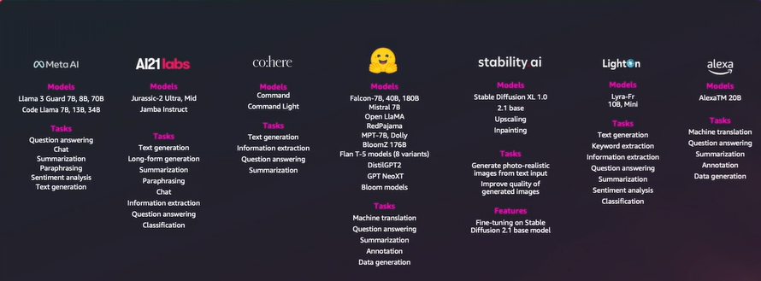
Some Models and Tasks - AWS
Ref: Adapted from 'AWS Innovate Conference, 2024', Presentation by Melwin Pais, Senior Solution Architect, AWS
Notes:
This slide provides an overview of various models and tasks available on AWS, showcasing their capabilities across AI domains. The content highlights contributions from multiple organizations and model types, illustrating the diversity of AI solutions. Below is a detailed explanation:
1. Meta AI
Models:
Llama 3 Guard (7B, 8B, 70B): Optimized for diverse NLP tasks.
Code Llama (78, 138, 34B): Tailored for code generation and analysis.
Tasks:
Question Answering: Extracting answers from context.
Summarization: Condensing lengthy text into concise summaries.
Paraphrasing: Rewriting text with similar meaning.
Sentiment Analysis: Classifying text as positive, negative, or neutral.
Text Generation: Creating coherent and contextually relevant text.
2. AI21 Labs
Models:
Jurassic-2 Ultra, Mid: Focused on high-quality text generation.
Jamba Instruct: Designed for instruction-following text generation tasks.
Tasks:
Text Generation: Generating fluent and meaningful text.
Long-form Generation: Creating extended content like articles or essays.
Information Extraction: Identifying key details from unstructured text.
Classification: Categorizing data into predefined classes.
3. Cohere
Models:
Command, Command Light: Specialized for NLP tasks.
Tasks:
Text Generation: Producing human-like text.
Information Extraction: Pulling structured data from text.
Question Answering: Answering user queries based on context.
Summarization: Simplifying long text while preserving meaning.
4. Stability AI
Models:
Stable Diffusion XL 1.0, 2.1 Base: Focused on generative AI for images.
Tasks:
Generate Images: Producing photo-realistic visuals from text input.
Upscaling: Enhancing the quality of low-resolution images.
Inpainting: Filling in missing or damaged parts of images.
Features:
Fine-tuning on Stable Diffusion 2.1 for specialized use cases.
5. LightOn
Models:
Lyra-Fr (10B, Mini): Optimized for multilingual tasks.
Tasks:
Text Generation: Fluent text creation in multiple languages.
Keyword Extraction: Identifying key phrases from documents.
Summarization: Condensing information into shorter formats.
Sentiment Analysis: Analyzing opinions and emotions in text.
6. Alexa
Models:
AlexaTM 20B: Powerful transformer model for diverse applications.
Tasks:
Machine Translation: Translating text between languages.
Question Answering: Answering factual or contextual questions.
Summarization: Simplifying text content.
Annotation: Labeling or tagging data for machine learning tasks.
Data Generation: Creating synthetic data for training or testing.
Key Takeaways
Versatility Across Domains: Models cover a wide array of tasks in NLP, computer vision, and generative AI.
Collaboration: Contributions from leading AI organizations like Meta AI, AI21 Labs, Cohere, Stability AI, and AWS.
Customization: Many models can be fine-tuned for specific tasks or domains.
Practical Applications
Businesses:
Sentiment analysis for customer feedback.
Summarization of large documents or datasets.
Generating high-quality marketing content.
Developers:
Leveraging pre-trained models for quick deployment.
Customizing models to meet domain-specific requirements.

Slide 33
Basics of Natural Language Processing
Notes:
This slide serves as the title slide for a section on the Basics of Natural Language Processing (NLP). Below is a detailed overview of what this title implies and what might follow in the subsequent slides:
1. What is Natural Language Processing (NLP)?
NLP is a subfield of artificial intelligence (AI) focused on enabling machines to understand, interpret, and generate human language.
It bridges the gap between human communication (natural languages like English, Hindi, etc.) and machine-readable formats (structured data, binary code).
2. Key Components of NLP
Syntax: Understanding the grammatical structure of sentences.
Semantics: Capturing the meaning of words and phrases.
Pragmatics: Analyzing language in context, considering tone, intent, and culture.
3. Common Applications of NLP
Text Classification: Categorizing text into predefined labels (e.g., spam detection).
Sentiment Analysis: Determining the sentiment expressed in text (positive, negative, neutral).
Machine Translation: Translating text from one language to another (e.g., Google Translate).
Question Answering: Building systems like chatbots or virtual assistants that respond to user queries.
Text Summarization: Reducing long passages into concise summaries.
Speech-to-Text and Text-to-Speech: Converting spoken language into text and vice versa.
4. Relevance of NLP
Daily Interactions: Used in applications like Siri, Alexa, Google Assistant, and chatbots.
Business Impact:
Automates customer support.
Analyzes customer reviews and feedback.
Research and Development:
Enhances human-computer interaction.
Aids in extracting insights from large textual datasets.
5. Potential Topics in this Section
Introduction to NLP: Definitions, scope, and challenges.
NLP Pipelines: Step-by-step processes for handling language tasks.
Core Techniques:
Tokenization, stemming, lemmatization.
Named Entity Recognition (NER).
Advanced NLP:
Transformer models like BERT, GPT.
Transfer learning and fine-tuning for NLP tasks.
Evaluation Metrics:
BLEU, ROUGE, perplexity, F1-score.
Key Takeaway
The title sets the stage for a deep dive into the foundational concepts, tools, and techniques of NLP, showcasing its importance and practical applications in AI-driven solutions.

Slide 34
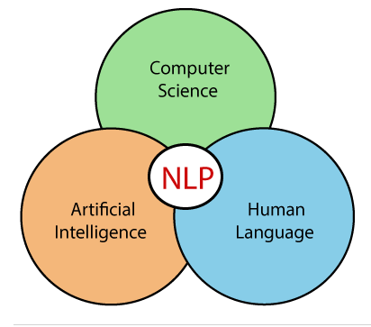
NLP
NLP stands for Natural Language Processing
Subfield of Computer Science, Human language (Linguistics), and Artificial Intelligence
It is the technology that is used by machines to understand, analyze, manipulate, and interpret human's languages.
Notes:
This slide introduces Natural Language Processing (NLP) by defining its scope, interdisciplinary nature, and functionality. Here's a detailed explanation:
1. Definition of NLP
NLP: Stands for Natural Language Processing.
A technology enabling machines to understand, analyze, manipulate, and interpret human language.
Bridges the gap between human communication (natural languages) and machine-readable data.
2. Interdisciplinary Nature of NLP
NLP is at the intersection of:
Computer Science:
Algorithms, computational models, and data structures form the backbone for processing natural language.
Artificial Intelligence (AI):
Enables machines to mimic human cognitive abilities, such as language understanding and reasoning.
Human Language (Linguistics):
Involves understanding grammar, syntax, semantics, and pragmatics to process language accurately.
The Venn diagram illustrates NLP as a convergence of these three disciplines.
3. Core Objective of NLP
The primary goal is to create systems that:
Understand and interpret human language effectively.
Interact seamlessly with humans through text or speech.
4. Applications of NLP
Chatbots: Conversational agents for customer support.
Sentiment Analysis: Gauging public opinion or customer feedback.
Machine Translation: Tools like Google Translate for cross-language communication.
Speech Recognition: Converting spoken language into text (e.g., Siri, Alexa).
Text Summarization: Generating concise summaries of long documents.
Information Extraction: Pulling relevant details from unstructured text.
5. Importance of NLP
Human-Machine Interaction:
Enables natural communication between users and systems.
Automation:
Processes large volumes of textual data efficiently.
Insights:
Derives meaningful patterns and trends from text data for decision-making.
Key Takeaways
NLP is a multidisciplinary field drawing from AI, linguistics, and computer science.
It forms the foundation of modern AI applications that deal with text and speech.

Slide 35
Basics of NLP
Users can provide two kinds of input to Machine –> Text or Speech
Machine has to first understand the human speech in order to act on it
Examples:
User types a message “BITS Pilani” in Google Search
User tells Alexa “Play me Kishore Kumar Songs”
In both the examples, Machine should understand the Syntax, Semantics, Context and Intent of the statement, in order to provide a favorable reply.
Notes:
This slide introduces the Basics of NLP by explaining how machines process user input in text and speech formats and the importance of understanding syntax, semantics, context, and intent. Here's a detailed breakdown:
1. Types of Input
Text Input:
Users type queries or commands.
Example: "User types a message 'BITS Pilani' in Google Search."
The machine processes the text to fetch relevant search results.
Speech Input:
Users give spoken commands or questions.
Example: "User tells Alexa, 'Play me Kishore Kumar Songs.'"
The machine converts speech to text and then processes the command to play the requested songs.
2. Machine's Role in Understanding Input
Before acting on user input, the machine needs to:
Understand the text or speech provided.
Identify key components such as:
Syntax: The grammatical structure of the statement.
Semantics: The meaning conveyed by the words and sentences.
Context: The background or situation influencing the statement.
Intent: The user's purpose or goal behind the input.
3. Examples Explained
Google Search Example:
Input: "BITS Pilani."
Machine Task:
Parse the text query.
Identify "BITS Pilani" as a proper noun (possibly an educational institute).
Fetch and display relevant search results.
Alexa Example:
Input: "Play me Kishore Kumar Songs."
Machine Task:
Convert speech to text.
Understand the intent: The user wants to listen to Kishore Kumar's music.
Execute the action: Find and play the requested songs.
4. Importance of Syntax, Semantics, Context, and Intent
Syntax:
Ensures the input follows a recognizable grammatical structure.
Example: Differentiating between a statement and a question.
Semantics:
Deciphers the meaning behind words or phrases.
Example: Understanding that "Play" refers to audio playback in this context.
Context:
Interprets the background information for relevance.
Example: If the user has previously mentioned liking old Hindi songs, the system might prioritize Kishore Kumar's most popular tracks.
Intent:
Identifies the user's desired outcome.
Example: The intent is to play songs, not search for information about Kishore Kumar.
5. Key Takeaways
NLP relies on accurately processing both text and speech inputs.
Machines must combine syntactic, semantic, contextual, and intent analysis to provide meaningful responses.
These principles form the foundation of intelligent systems like search engines, virtual assistants, and chatbots.

Slide 36
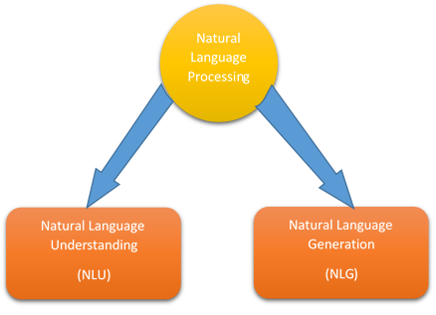
Components of NLP
Understands the Human Speech
Process and Action
Notes:
This slide explains the two key components of Natural Language Processing (NLP): Natural Language Understanding (NLU) and Natural Language Generation (NLG). Here's a detailed explanation:
1. Natural Language Processing (NLP)
NLP is the overarching process that encompasses:
Understanding human language (input processing).
Generating responses or actions (output processing).
It forms the backbone of applications like virtual assistants, chatbots, and search engines.
2. Components of NLP
A. Natural Language Understanding (NLU)
Definition: Focuses on understanding and interpreting human language input.
Key Functions:
Speech-to-Text: Converting spoken words into written text.
Tokenization: Breaking text into smaller units like words or phrases.
Syntax Analysis: Understanding the grammatical structure of sentences.
Semantics: Determining the meaning of words and sentences.
Named Entity Recognition (NER): Identifying specific entities like names, dates, and locations.
Intent Recognition: Understanding the user’s purpose (e.g., asking a question, making a request).
Output: Structured data or context for further processing.
Example: Alexa understanding the command, "Play Kishore Kumar songs."
B. Natural Language Generation (NLG)
Definition: Focuses on generating human-like responses or actions based on the processed input.
Key Functions:
Text Generation: Creating coherent and contextually relevant text.
Speech Synthesis: Converting written text into speech.
Summarization: Condensing lengthy text into shorter formats.
Report Generation: Creating structured output like emails or reports.
Output: Human-readable or actionable responses.
Example: Alexa responding with, "Playing Kishore Kumar's top songs now."
3. Relationship Between NLU and NLG
NLU and NLG are interconnected:
NLU: Processes and understands the input (e.g., what the user said or typed).
NLG: Generates appropriate output or response (e.g., a verbal response, action execution).
Together, they form a complete NLP system enabling intelligent human-machine interaction.
4. Examples of Applications
Virtual Assistants (Alexa, Siri, Google Assistant):
NLU: Understands commands like "Set an alarm for 7 AM."
NLG: Responds with "Alarm set for 7 AM."
Customer Support Chatbots:
NLU: Understands user complaints or queries.
NLG: Provides pre-programmed or AI-generated solutions.
Key Takeaways
NLU enables machines to understand human language.
NLG allows machines to generate meaningful responses.
Together, they make human-machine communication seamless and effective.

Slide 37
Components of NLP
NLU
Understand the Text
Understand Syntax, Context, Sentiment, Semantics and Intent from the text
Syntactic Analysis
Lemmatization, Stemming, Word Segmentation, POS tagging etc.
Semantic Analysis
Named Entity Recognition (NER), Word Sense Disambiguation etc.
Notes:
This slide delves into the Natural Language Understanding (NLU) aspect of NLP, highlighting its role and methodologies for processing and comprehending human language. Below is a detailed explanation:
1. Role of NLU
NLU is a core component of NLP that focuses on making sense of human language by analyzing the input to derive structured and meaningful information.
It involves:
Understanding the text at a syntactic, semantic, and contextual level.
Deciphering intent, sentiment, and meaning behind the input.
2. Key Concepts in NLU
A. Understanding Syntax, Context, Sentiment, Semantics, and Intent
Syntax:
Focuses on the grammatical structure of sentences.
Ensures the text adheres to linguistic rules.
Context:
Considers the surrounding text or situation to interpret meaning accurately.
Example: The word "bank" could mean a financial institution or a riverbank depending on the context.
Sentiment:
Analyzes emotions conveyed in the text (positive, negative, neutral).
Semantics:
Deals with the meaning of words, phrases, and sentences.
Intent:
Determines the purpose behind the input, such as a request, question, or command.
3. Methods in NLU
A. Syntactic Analysis
Focuses on the grammatical arrangement of words and phrases.
Techniques:
Lemmatization:
Reduces words to their base or dictionary form.
Example: "running" → "run."
Stemming:
Trims words to their root form.
Example: "runs," "running" → "run."
Word Segmentation:
Breaks text into words, especially for languages without spaces (e.g., Chinese, Japanese).
Part-of-Speech (POS) Tagging:
Identifies parts of speech (e.g., noun, verb, adjective) for each word.
B. Semantic Analysis
Focuses on extracting meaning from the text.
Techniques:
Named Entity Recognition (NER):
Identifies entities like names, dates, locations, etc.
Example: "BITS Pilani" is recognized as an organization.
Word Sense Disambiguation:
Determines the correct meaning of a word based on context.
Example: "bat" as in "cricket bat" versus "bat" as in the flying mammal.
4. Practical Applications of NLU
Chatbots and Virtual Assistants:
Example: Identifying and responding to user queries accurately.
Search Engines:
Understanding the user's query to fetch relevant results.
Customer Feedback Analysis:
Analyzing sentiment and intent behind reviews and ratings.
Healthcare:
Extracting patient information and symptoms from medical records.
Key Takeaways
NLU is vital for interpreting human language and converting it into a machine-readable format.
Techniques like lemmatization, stemming, and NER enhance the machine’s ability to understand and process natural language.
Effective NLU ensures systems can provide relevant and meaningful responses.

Slide 38
Components of NLP
NLG
Produce meaningful sentences in human-understandable text
NLG Models:
Markov Chain
Recurrent Neural Network (RNN)
Long Short-Term Memory (LSTM)
Transformer
Notes:
This slide focuses on Natural Language Generation (NLG), the process of generating meaningful and human-understandable text from machine-processed data. Below is a detailed explanation:
1. What is NLG?
Natural Language Generation (NLG) is a subfield of NLP that transforms structured data or machine-understood information into coherent and meaningful sentences in human-readable formats.
It is the counterpart to Natural Language Understanding (NLU), where the focus is on producing output rather than understanding input.
2. Purpose of NLG
Goal: To enable machines to communicate with humans in natural language.
It involves:
Generating responses in chatbots or virtual assistants.
Creating summaries for lengthy documents.
Producing reports, articles, or emails automatically.
3. Models Used in NLG
A. Markov Chain
A probabilistic model that predicts the next word based on the previous one or a small sequence of prior words.
Use Case: Basic text generation tasks, such as generating sentences or simple chatbot responses.
Limitation: Struggles with understanding long-range dependencies in text.
B. Recurrent Neural Network (RNN)
A type of neural network designed for sequential data processing.
Processes one word at a time, maintaining a hidden state to remember previous information.
Use Case: Early models for text generation and sequential tasks.
Limitation: Suffers from vanishing gradient problems, making it less effective for long text sequences.
C. Long Short-Term Memory (LSTM)
A specialized version of RNN designed to overcome the vanishing gradient issue.
Can learn long-range dependencies, making it suitable for generating meaningful and contextually coherent text.
Use Case: Summarization, dialogue generation, and text prediction.
D. Transformer
The most advanced architecture for NLG tasks, leveraging mechanisms like self-attention.
Handles long-range dependencies and parallelizes processing, making it highly efficient.
Popular Examples:
GPT (Generative Pre-trained Transformer) for text generation.
BERT (Bidirectional Encoder Representations from Transformers) for understanding-based generation tasks.
Use Case: Summarization, translation, content creation, and more.
4. Applications of NLG
Virtual Assistants: Generating spoken or textual responses (e.g., Alexa or Siri).
Report Generation: Automatically creating business or medical reports.
Text Summarization: Condensing lengthy articles into concise summaries.
Personalized Content: Drafting personalized emails or recommendations.
5. Advantages of NLG
Efficiency: Automates repetitive text creation tasks.
Personalization: Tailors responses to user preferences or contexts.
Scalability: Handles large-scale content generation, such as news articles or customer support answers.
Key Takeaways
NLG focuses on producing meaningful and human-like text.
Models like Markov Chains are suitable for simpler tasks, while Transformers excel in complex, context-rich text generation.
NLG drives the creation of intelligent applications for communication, reporting, and content generation.

Slide 39
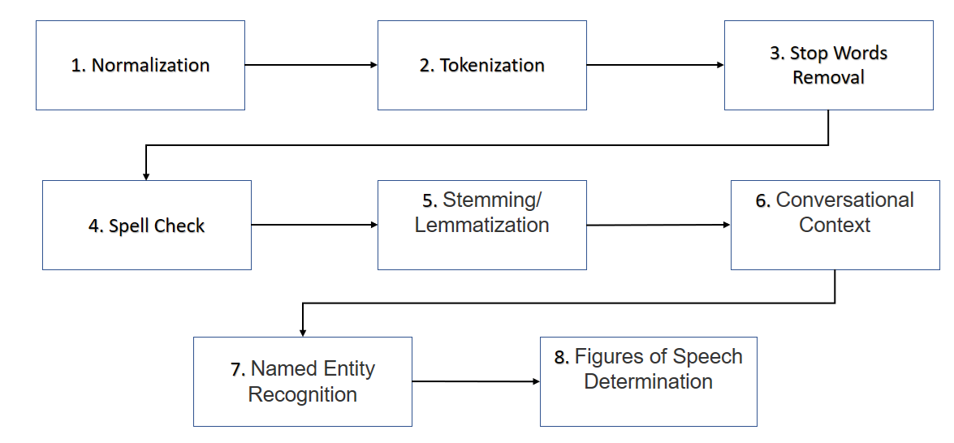
Sample NLP Pipeline for NLU
Notes:
This slide presents a Sample NLP Pipeline for Natural Language Understanding (NLU), breaking down the sequential stages involved in processing and interpreting human language input. Here's a detailed explanation of each step:
1. Normalization
Purpose: Standardizes the text by transforming it into a uniform format.
Key Processes:
Converting all characters to lowercase.
Removing special characters (e.g., punctuation, symbols).
Expanding contractions (e.g., "can't" → "cannot").
Example:
Input: "HELLO, World!!"
Output: "hello world"
2. Tokenization
Purpose: Splits text into smaller units (tokens), such as words or sentences.
Key Processes:
Sentence Tokenization: Splits text into individual sentences.
Word Tokenization: Further splits sentences into words.
Example:
Input: "Natural Language Processing is amazing."
Output: ["Natural", "Language", "Processing", "is", "amazing"]
3. Stop Words Removal
Purpose: Eliminates commonly used words (e.g., "is," "the," "and") that do not contribute significant meaning.
Example:
Input: "Natural Language Processing is amazing."
Output: ["Natural", "Language", "Processing", "amazing"]
4. Spell Check
Purpose: Detects and corrects spelling errors to improve the accuracy of text processing.
Example:
Input: "Natrual Languae Procesing"
Output: "Natural Language Processing"
5. Stemming/Lemmatization
Stemming: Reduces words to their root form by removing suffixes.
Example: "running," "runner" → "run."
Lemmatization: Converts words to their base or dictionary form, considering the context.
Example: "running" → "run," "better" → "good."
6. Conversational Context
Purpose: Analyzes the surrounding text or conversation to understand the context and meaning of the input.
Example:
Query: "Play the song."
Context: The user previously mentioned "Imagine by John Lennon."
Interpretation: "Play the song 'Imagine by John Lennon.'"
7. Named Entity Recognition (NER)
Purpose: Identifies and categorizes specific entities in text, such as names, dates, locations, and organizations.
Example:
Input: "BITS Pilani was established in 1964."
Output: {"Organization": "BITS Pilani", "Year": "1964"}
8. Figures of Speech Determination
Purpose: Recognizes figurative language (e.g., metaphors, similes) to interpret nuanced meanings.
Example:
Input: "Time is a thief."
Output: Understanding that "time is a thief" implies the passage of time can take away opportunities.
Purpose of This Pipeline
This sequential approach ensures the raw text is processed into a format that can be understood by machines for further analysis or action.
Each stage refines and structures the text, enabling tasks like sentiment analysis, intent recognition, and text classification.
Applications
Virtual Assistants: Understanding user queries and context.
Chatbots: Processing user input for accurate responses.
Search Engines: Interpreting queries to fetch relevant results.

Slide 40
Tools for NLU
Stanford CoreNLP Parser (Python)
NLTK – Natural Language Toolkit (Python)
SpaCy (Python)
Apache OpenNLP (opensource Java Library)
Notes:
This slide presents Tools for Natural Language Understanding (NLU). Here's an explanation of the listed tools:
1. Stanford CoreNLP Parser (Python)
Description: A comprehensive suite of NLP tools developed by Stanford University. It includes capabilities for part-of-speech tagging, named entity recognition, sentiment analysis, dependency parsing, and more.
Features:
Language models for multiple languages.
Can be used as a Java library or through Python wrappers like Stanza or py-corenlp.
Use Cases:
Dependency parsing.
Semantic role labeling.
2. NLTK – Natural Language Toolkit (Python)
Description: A leading library for working with human language data in Python.
Features:
Text preprocessing tools (tokenization, stemming, lemmatization).
Built-in corpora like WordNet and annotated datasets.
Tools for machine learning integration and custom pipeline creation.
Use Cases:
Text preprocessing for NLP tasks.
Sentiment analysis and document classification.
3. SpaCy (Python)
Description: A modern, high-performance NLP library designed for both research and production. Known for its speed and accuracy.
Features:
Pretrained pipelines for tokenization, POS tagging, dependency parsing, and named entity recognition.
Easy integration with deep learning frameworks like TensorFlow and PyTorch.
Use Cases:
Real-time NLP in applications.
Named Entity Recognition (NER) and text classification.
4. Apache OpenNLP (Open-source Java Library)
Description: An open-source NLP library written in Java. Provides a set of tools for tokenization, sentence segmentation, POS tagging, chunking, and NER.
Features:
Machine learning-based tools for NLP tasks.
Flexibility for building custom NLP models.
Use Cases:
Java-based NLP applications.
Customizable NLP pipelines for specialized tasks.
Comparative Strengths
Stanford CoreNLP: Best for academic research with detailed linguistic analysis.
NLTK: Ideal for beginners and educational purposes due to extensive documentation and ease of use.
SpaCy: Preferred for production-level applications due to its speed and scalability.
Apache OpenNLP: Suitable for Java developers and projects that require machine learning-based customization.

Slide 41
Demo
Sample Python Program to demonstrate NLU and NLP Pipeline using NLTK Library
Notes:
This slide sets the stage for a Demo showcasing a Python program that demonstrates the use of the NLTK library to build an NLU (Natural Language Understanding) and NLP (Natural Language Processing) pipeline.
The demo will likely involve the following components:
Key Features of the Demo
NLU and NLP Pipeline:
How raw text is processed and analyzed using NLTK functions.
A step-by-step breakdown of tasks like tokenization, stemming, lemmatization, and entity recognition.
Python Implementation:
Use of the NLTK library to showcase the implementation of core NLP concepts.
Likely integration of multiple NLTK modules such as nltk.tokenize, nltk.corpus, and nltk.stem.
Hands-On Illustration:
Practical examples like analyzing a sample text for:
Part-of-Speech (POS) tagging.
Named Entity Recognition (NER).
Syntactic and semantic processing.
Learning Objectives:
Understand how to set up a basic NLP pipeline using NLTK.
Get hands-on with preprocessing and feature extraction for NLP tasks.
-
Here's a Python code snippet demonstrating a basic NLP pipeline using the NLTK library:
Example NLP Pipeline with NLTK
pythonCopy codeimport nltkfrom nltk.tokenize import word_tokenize, sent_tokenizefrom nltk.corpus import stopwordsfrom nltk.stem import WordNetLemmatizerfrom nltk import pos_tag, ne_chunk # Download necessary NLTK datasets (only the first time)nltk.download('punkt')nltk.download('stopwords')nltk.download('averaged_perceptron_tagger')nltk.download('wordnet')nltk.download('maxent_ne_chunker')nltk.download('words') # Sample Texttext = """BITS Pilani is one of India's leading institutes of higher education.It is located in Pilani, Rajasthan, and was founded in 1964.""" # Step 1: Sentence Tokenizationprint("Sentence Tokenization:")sentences = sent_tokenize(text)print(sentences) # Step 2: Word Tokenizationprint("\nWord Tokenization:")words = word_tokenize(text)print(words) # Step 3: Removing Stop Wordsprint("\nRemoving Stop Words:")stop_words = set(stopwords.words('english'))filtered_words = [word for word in words if word.lower() not in stop_words]print(filtered_words) # Step 4: Lemmatizationprint("\nLemmatization:")lemmatizer = WordNetLemmatizer()lemmatized_words = [lemmatizer.lemmatize(word) for word in filtered_words]print(lemmatized_words) # Step 5: Part-of-Speech (POS) Taggingprint("\nPart-of-Speech Tagging:")pos_tags = pos_tag(words)print(pos_tags) # Step 6: Named Entity Recognition (NER)print("\nNamed Entity Recognition:")entities = ne_chunk(pos_tags)print(entities) # Step 7: Displaying Named Entitiesprint("\nNamed Entities:")for subtree in entities.subtrees(): if subtree.label() in ["PERSON", "ORGANIZATION", "GPE"]: # GPE: Geo-Political Entity print(subtree)
Output Explanation
Sentence Tokenization: Breaks text into sentences.
Example Output: ['BITS Pilani is one of India\'s leading institutes of higher education.', 'It is located in Pilani, Rajasthan, and was founded in 1964.']
Word Tokenization: Splits sentences into individual words.
Example Output: ['BITS', 'Pilani', 'is', 'one', 'of', 'India', "'s", 'leading', 'institutes', ...]
Removing Stop Words: Filters out common words (e.g., "is", "of") that do not add much meaning.
Example Output: ['BITS', 'Pilani', 'India', 'leading', 'institutes', 'higher', 'education', ...]
Lemmatization: Reduces words to their base form (e.g., "institutes" → "institute").
Example Output: ['BITS', 'Pilani', 'India', 'leading', 'institute', 'higher', 'education', ...]
POS Tagging: Assigns grammatical tags (e.g., noun, verb) to each word.
Example Output: [('BITS', 'NNP'), ('Pilani', 'NNP'), ('is', 'VBZ'), ('one', 'CD'), ...]
Named Entity Recognition (NER): Identifies entities like names of places, organizations, and people.
Example Output: Tree('GPE', [('BITS', 'NNP'), ('Pilani', 'NNP')])
Run the Code
Copy and paste this code into your Python environment.
Install NLTK if not already done: pip install nltk.

Slide 42
Application of Transformers in NLP

Slide 43
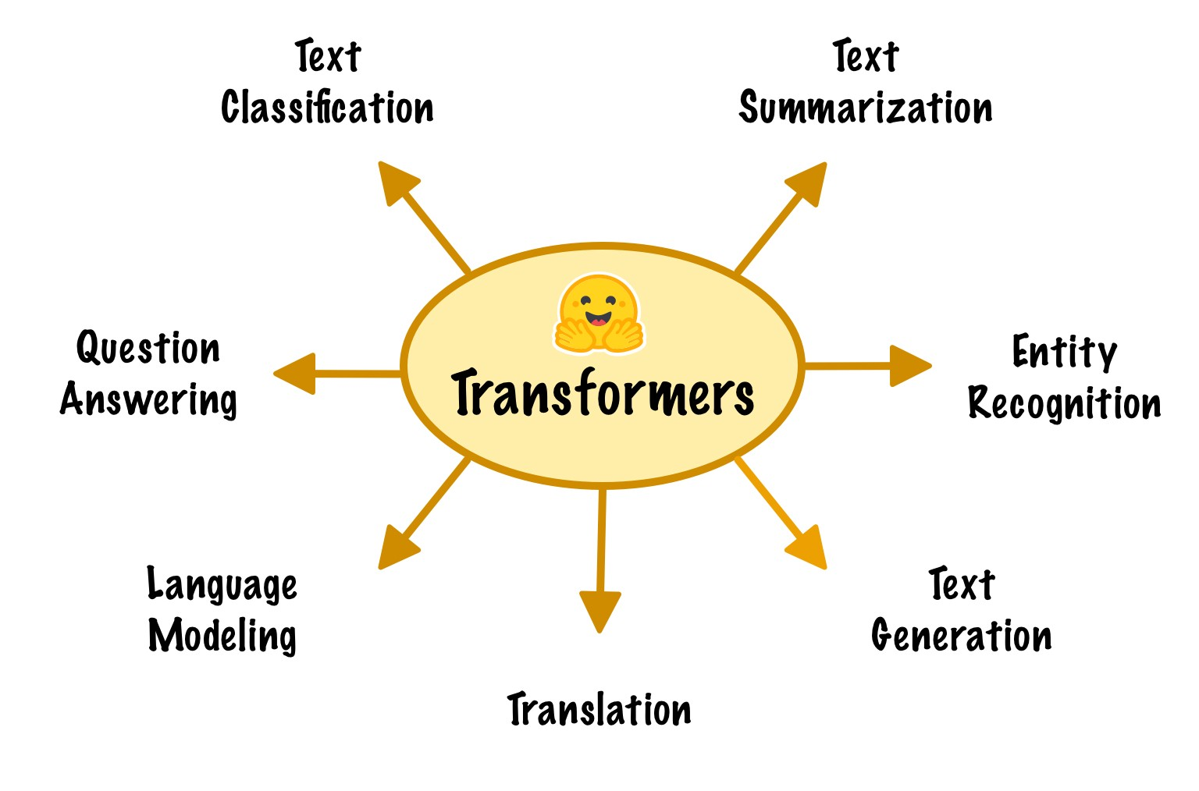
Applications of Transformers in NLP
Notes:
The slide highlights the transformer architecture and its applications across various NLP tasks. Transformers, introduced by Vaswani et al. in 2017 in the paper "Attention is All You Need," have become the backbone of state-of-the-art models like BERT, GPT, and T5. They excel at capturing long-range dependencies in text using self-attention mechanisms. Below is a breakdown of each application with detailed insights.
1. Text Classification
Description: Text classification is the process of assigning categories or labels to a given text. Transformers analyze the context of the text and classify it based on the task.
Examples:
Sentiment Analysis: Classifying text as positive, negative, or neutral (e.g., reviews of products or movies).
Topic Classification: Categorizing articles into topics like sports, politics, or technology.
Spam Detection: Identifying spam emails from genuine ones.
How Transformers Help:
Models like BERT (Bidirectional Encoder Representations from Transformers) understand the bidirectional context of sentences, making them effective for accurate classification.
2. Text Summarization
Description: This involves creating concise summaries of longer texts while preserving their meaning and essential information.
Types:
Extractive Summarization: Extracts important sentences or phrases directly from the text.
Abstractive Summarization: Generates new sentences that convey the core ideas of the text.
Examples:
Summarizing news articles for busy readers.
Summarizing customer reviews for product insights.
How Transformers Help:
Models like T5 (Text-to-Text Transfer Transformer) and BART (Bidirectional and Auto-Regressive Transformers) generate high-quality, human-like summaries by understanding and synthesizing context.
3. Entity Recognition
Description: Named Entity Recognition (NER) identifies specific entities within text and classifies them into predefined categories like names, dates, or locations.
Examples:
Extracting "Barack Obama" as a person and "United States" as a location from the sentence: Barack Obama was the 44th president of the United States.
Identifying medical terms in healthcare records.
How Transformers Help:
Pre-trained transformers like SpaCy’s Transformer Pipeline or BERT excel at recognizing entities due to their ability to understand context over long sentences.
4. Text Generation
Description: This involves creating coherent and contextually relevant text that appears human-generated. Text generation can be open-ended or constrained.
Examples:
Chatbots: Generating replies to user queries.
Creative Writing: Producing poetry, stories, or lyrics.
Code Generation: Models like GitHub Copilot help programmers by completing code snippets.
How Transformers Help:
Models like GPT (Generative Pre-trained Transformer) can generate text by predicting the next word in a sequence based on context, producing human-like outputs.
5. Translation
Description: Machine translation converts text from one language to another while maintaining semantic integrity.
Examples:
Translating a user manual from English to Spanish.
Real-time language translation in applications like Google Translate.
How Transformers Help:
Transformer-based architectures such as Google's Transformer and OpenNMT have replaced traditional sequence-to-sequence models like RNNs and LSTMs, achieving state-of-the-art performance in translation tasks.
6. Language Modeling
Description: Language modeling predicts the likelihood of a sequence of words and is fundamental to various NLP applications.
Examples:
Autocomplete: Predicting the next word as you type (e.g., smartphone keyboards or search engines).
Text Completion: Filling in missing words in a sentence or paragraph.
How Transformers Help:
Models like BERT are pre-trained on massive corpora to predict masked words, while GPT predicts the next word based on the sequence so far. These capabilities enable advanced natural language understanding and generation.
7. Question Answering
Description: Question answering involves extracting or generating precise answers to user queries based on context or a provided document.
Types:
Extractive QA: Extracting the exact span of text that contains the answer.
Generative QA: Producing an answer in natural language.
Examples:
Virtual assistants like Siri or Alexa answering factual questions.
Search engines providing direct answers to user queries.
How Transformers Help:
Models like BERT and DistilBERT fine-tuned on datasets like SQuAD (Stanford Question Answering Dataset) excel in understanding the context and pinpointing answers.
Advantages of Transformers in NLP
Parallel Processing: Unlike RNNs, transformers process input sequences in parallel, enabling faster computations.
Contextual Understanding: The self-attention mechanism captures relationships between all words in a sequence, allowing for better context comprehension.
Scalability: Transformers can handle massive datasets and support training large-scale models like GPT-4 and BERT.
Real-World Impact of Transformers
Hugging Face: The hugging emoji shown on the slide refers to Hugging Face, a popular platform that provides pre-trained transformer models and tools for easy implementation in NLP projects.
Industry Adoption: From healthcare to e-commerce, transformers are driving innovation in applications like virtual assistants, automated customer support, and intelligent document processing.
This combination of applications demonstrates why transformers are at the core of modern NLP advancements, replacing older methods like RNNs and LSTMs.
4o

Slide 44
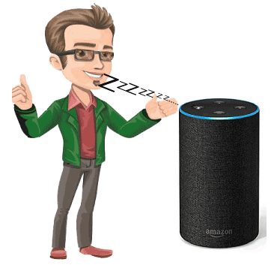
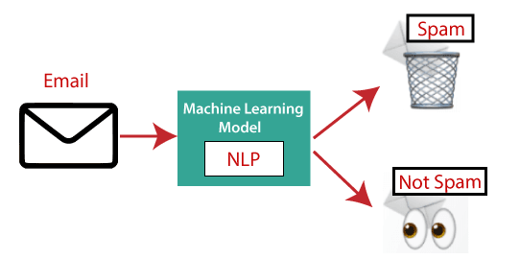
Applications of Transformers (NLP)
Question – Answering
Question Answering focuses on building systems that automatically answer the questions asked by humans in a natural language.
Ex: Virtual Assistants (Alexa, Google Mini)
Spam detection
Is used to detect unwanted e-mails getting to a user's inbox.
Notes:
This slide provides examples of specific applications of Transformers in NLP, focusing on Question Answering and Spam Detection. Here’s a detailed breakdown of these concepts:
1. Question Answering (QA)
Overview:
Definition: QA systems aim to automatically answer questions posed in natural language by understanding the question and retrieving or generating relevant responses.
Example Use Cases:
Virtual Assistants (e.g., Amazon Alexa, Google Assistant).
Customer Support Chatbots.
Educational Tools for quick query resolution.
Transformer's Role:
Self-Attention Mechanism:
Enables understanding of the relationships between words in both the question and the context.
For instance, in the query: "Who is the CEO of Tesla?", the model focuses on "CEO" and "Tesla" while ignoring irrelevant parts of the context.
Pre-Trained Models:
Transformers like BERT and RoBERTa fine-tuned on QA datasets like SQuAD provide state-of-the-art performance by extracting answers from passages.
Examples:
Alexa responds to "What’s the weather today?" by processing user input and generating relevant weather information.
Google's "Featured Snippets" use transformer-based models to provide answers directly in search results.
2. Spam Detection
Overview:
Definition: Spam detection involves identifying and filtering out unwanted or irrelevant emails, ensuring only genuine messages reach the inbox.
Example Use Cases:
Email clients (e.g., Gmail) automatically moving suspicious emails to the Spam folder.
Enterprise systems identifying phishing attempts or malicious links.
Transformer's Role:
Contextual Understanding:
Transformers analyze entire email content (not just keywords) to determine its intent and classify it as "spam" or "not spam."
Advantages:
They can detect subtle patterns, such as repetitive phrases, hyperlinks, or unusual sender details, which rule-based systems often miss.
Pre-Trained Models:
Models like BERT fine-tuned on labeled spam datasets learn to classify emails more effectively than traditional approaches.
Pipeline:
Input: Email content is fed into the model.
NLP Processing: The transformer processes the email text using its attention mechanism.
Output: The model classifies the email as "Spam" (redirected to the spam folder) or "Not Spam" (delivered to the inbox).
Illustrations in the Slide:
QA Illustration:
Depicts a user asking a question to a virtual assistant (e.g., Alexa or Google Mini).
Highlights the seamless interaction where transformers power the assistant to interpret and respond in natural language.
Spam Detection Illustration:
Shows an email pipeline:
Emails are processed by an NLP-powered machine learning model.
The model labels emails as either Spam (sent to a trash bin) or Not Spam (sent to the inbox).
Real-World Impact:
Question Answering:
Revolutionized user experiences in virtual assistants and automated systems by enabling natural and intuitive communication.
Spam Detection:
Improved cybersecurity and email hygiene, protecting users from phishing attempts and unwanted advertisements.
This slide demonstrates the transformative potential of NLP and transformers in practical, real-world applications.

Slide 45

Applications of Transformers (NLP)
Sentiment Analysis
Also called “Opinion Mining”
This application is implemented through a combination of NLP (Natural Language Processing) and statistics by assigning the values to the text (positive, negative, or natural), identify the mood of the context (happy, sad, angry, etc.)
Notes:
This slide focuses on Sentiment Analysis, one of the key applications of Transformers in NLP (Natural Language Processing). Below is a detailed explanation:
What is Sentiment Analysis?
Definition: Sentiment analysis, also known as opinion mining, involves determining the sentiment, tone, or emotion expressed in a piece of text. It classifies text into categories such as positive, negative, or neutral.
Goal: Understand the underlying emotion or opinion in text to make data-driven decisions.
Example Use Cases:
Analyzing customer feedback to gauge satisfaction.
Assessing public sentiment about a product or policy on social media.
How Sentiment Analysis Works with NLP?
Text Preprocessing:
Text data is cleaned (removing special characters, stop words, etc.) and tokenized.
Context Understanding:
Sentiment often depends on the relationship between words. For example, "This product is not great" is negative despite "great" being a positive word.
Traditional methods like Bag-of-Words fail to capture such nuances.
Statistical Models:
Sentiment analysis uses a combination of NLP techniques and statistical methods to assign a sentiment score or label to text.
Role of Transformers in Sentiment Analysis
Transformers have revolutionized sentiment analysis by their ability to:
Understand Context:
Transformers, like BERT (Bidirectional Encoder Representations from Transformers), use a bidirectional attention mechanism to understand the relationship between all words in a sentence.
Example: They distinguish the sentiment in "I’m not happy" (negative) vs. "I’m happy" (positive).
Handle Large Text Datasets:
They can process lengthy reviews, social media posts, or survey data efficiently, maintaining high accuracy.
Pre-Trained Models:
Models like RoBERTa, ALBERT, and DistilBERT are pre-trained on massive datasets, enabling faster implementation and better results when fine-tuned on specific sentiment analysis tasks.
Applications of Sentiment Analysis
Social Media Monitoring:
Companies monitor public sentiment about their brand on platforms like Twitter or Instagram.
Example: Analyzing tweets during a product launch to measure success.
Customer Feedback:
Analyzing online reviews or surveys to improve products and services.
Example: Classifying reviews on Amazon as positive, negative, or neutral.
Financial Forecasting:
Monitoring public sentiment about stocks or economic conditions to inform decisions.
Example: Analyzing news sentiment for stock price predictions.
Political Sentiment:
Gauging public opinion about candidates or policies based on news articles and social media posts.
Illustration on the Slide
The slide uses a set of emoticons to represent different sentiments:
Laughing Face: Represents positive emotions or happiness.
Sad Faces: Reflect negative or unhappy emotions.
Neutral Smiley: Indicates neutral or indifferent sentiment.
These visual representations align with how sentiment analysis categorizes text into emotional labels like happy, sad, angry, or neutral.
Advantages of Transformers in Sentiment Analysis
Accuracy: High precision and recall due to their ability to model complex language structures.
Scalability: Can process large datasets efficiently.
Adaptability: Easily fine-tuned for specific domains, such as healthcare, e-commerce, or finance.
Transformers have made sentiment analysis more reliable and impactful, enabling industries to leverage emotional insights for better decision-making.

Slide 46
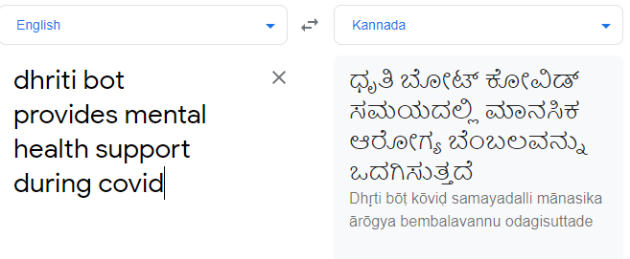
Applications of Transformers (NLP)
Machine translation
Is used to translate text or speech from one natural language to another natural language.
Notes:
This slide highlights Machine Translation, a core application of Transformers in NLP (Natural Language Processing). Below is a detailed explanation:
What is Machine Translation?
Definition: Machine translation is the process of automatically translating text or speech from one natural language (e.g., English) to another (e.g., Kannada) while preserving the meaning.
Goal: Enable seamless communication across languages, breaking linguistic barriers.
Example Use Cases:
Translating documents, webpages, or messages into different languages.
Facilitating real-time translation in applications like Google Translate or Microsoft Translator.
How Machine Translation Works?
Traditional Approach:
Early methods relied on rule-based systems or statistical models, which required extensive linguistic knowledge and manual effort.
These systems often struggled with contextual understanding and idiomatic expressions.
Neural Machine Translation (NMT):
NMT uses deep learning to model translation tasks, enabling better context understanding and natural-sounding translations.
Example: Translating "I’m feeling blue" to "ನಾನು ದುಃಖಿಸುತ್ತಿದ್ದೇನೆ" in Kannada captures the figurative meaning of the phrase.
Role of Transformers in Machine Translation
Transformers have revolutionized NMT by introducing advanced techniques:
Self-Attention Mechanism:
Allows the model to focus on the relationships between words in a sentence, regardless of their position.
Example: In the phrase "Dhriti bot provides mental health support during COVID," the model can link "mental health" with "support" even if other words separate them.
Sequence-to-Sequence Modeling:
Transformers employ encoder-decoder architectures for machine translation.
Encoder: Converts input text into a context-aware representation.
Decoder: Generates output text based on this representation in the target language.
Pre-Trained Models:
Models like mBERT (Multilingual BERT) and mT5 (Multilingual T5) are pre-trained on multiple languages, making them effective for translating between diverse language pairs.
Contextual Understanding:
Transformers capture nuances in text, such as idiomatic expressions, grammatical differences, and cultural references.
Example: Translating "It's raining cats and dogs" into Kannada as "ಭಾರೀ ಮಳೆ ಬರುತ್ತಿದೆ" instead of a literal translation.
Applications of Machine Translation
Healthcare:
Translating health information into local languages for accessibility.
Example: The slide shows an example related to mental health support during COVID, translated into Kannada.
Business Communication:
Enabling global businesses to communicate with clients and partners in their native languages.
Example: Translating contracts or marketing materials.
Education:
Making learning materials accessible to students in their preferred language.
Example: Translating online courses or research papers.
Travel and Tourism:
Providing instant translations for travelers via apps like Google Translate.
Example: Translating signs, menus, or spoken language in real-time.
Advantages of Transformers in Machine Translation
High Accuracy:
By understanding the context, transformers reduce errors in translation.
Scalability:
Pre-trained models can be fine-tuned for specific language pairs or domains.
Multilingual Capabilities:
Models like XLM (Cross-lingual Language Model) support multiple languages simultaneously, enabling translations across a wide range of language pairs.
Illustration in the Slide
The slide shows an example of translating the sentence "Dhriti bot provides mental health support during COVID" from English to Kannada:
Input (English): Dhriti bot provides mental health support during COVID.
Output (Kannada): ಧೃತಿಬೋಟ್ ಕೋವಿಡ್ ಸಮಯದಲ್ಲಿ ಮಾನಸಿಕ ಆರೋಗ್ಯ ಬೆಂಬಲವನ್ನು ಒದಗಿಸುತ್ತದೆ.
This demonstrates how transformers facilitate precise and meaningful translations, ensuring the message remains accurate in the target language.
Real-World Impact
Global Connectivity:
Facilitates cross-cultural communication and collaboration.
Efficiency:
Reduces the need for human translators, saving time and resources.
Accessibility:
Makes digital content available in local languages, enhancing inclusivity.
Transformers have set new benchmarks in machine translation, transforming how we interact across languages.

Slide 47
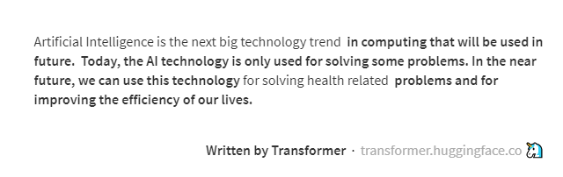
Applications of Transformers (NLP)
Text Generation
Used to generate text automatically based on user data and context.
Ref: https://transformer.huggingface.co/doc/gpt2-large
Notes:
This slide focuses on Text Generation, a powerful application of Transformers in NLP (Natural Language Processing). Below is a detailed explanation:
What is Text Generation?
Definition: Text generation is the task of automatically generating coherent and contextually appropriate text based on input data or context.
Goal: Produce human-like text for applications such as writing assistance, creative content generation, and chatbot responses.
Example Use Cases:
Generating articles, stories, or poetry.
Creating personalized email responses.
Assisting in code completion or document drafting.
How Text Generation Works?
Input Prompt:
The model receives an input (e.g., a phrase or topic) to guide text generation.
Example: Input prompt: "Artificial Intelligence is..."
Language Modeling:
The model predicts the next word, phrase, or sentence based on the context of the input and previously generated text.
Coherence and Fluency:
Text generation models aim to create grammatically correct, coherent, and contextually meaningful sentences.
Role of Transformers in Text Generation
Transformers excel in text generation tasks due to their advanced mechanisms:
Self-Attention Mechanism:
The self-attention mechanism enables the model to understand relationships between all words in the input and previously generated text.
Example: Ensuring that "AI technology" is referenced consistently throughout the generated content.
Pre-Trained Models:
Models like GPT (Generative Pre-trained Transformer) and GPT-2/3 have revolutionized text generation by being pre-trained on large corpora and fine-tuned for specific tasks.
Context Handling:
Transformers can generate coherent long-form content by maintaining context across sentences and paragraphs.
Open-Ended and Controlled Generation:
Open-Ended: Generating creative text without specific constraints.
Controlled: Guiding the output using input prompts or specific parameters.
Applications of Text Generation
Creative Content Generation:
Writing poems, stories, or music lyrics.
Example: Generating personalized greeting card messages.
Chatbots and Virtual Assistants:
Generating conversational responses.
Example: A chatbot generating empathetic responses for mental health support.
Writing Assistance:
Auto-completing sentences or paragraphs in writing tools.
Example: Google Docs suggesting text completion.
Code Generation:
Assisting developers with auto-completing code.
Example: GitHub Copilot powered by GPT-based transformers.
Summarization and Document Drafting:
Generating summaries or drafts of reports and articles.
Illustration in the Slide
The slide shows an example of text generated by a transformer model:
Input: A topic or partial text about Artificial Intelligence (AI).
Output: Coherent, fluent, and grammatically correct text describing AI trends and applications.
Tool Reference: Hugging Face’s transformer-based models (e.g., GPT-2).
Advantages of Transformers in Text Generation
Human-Like Quality:
Generates text that feels natural and contextually relevant.
Scalability:
Can handle diverse topics and large datasets.
Adaptability:
Pre-trained models can be fine-tuned for domain-specific tasks (e.g., legal or medical writing).
Real-World Impact
Enhanced Productivity:
Automates repetitive or time-consuming writing tasks.
Creative Assistance:
Provides inspiration or drafts for creative professionals.
Personalization:
Generates customized messages for users in e-commerce, marketing, or customer support.
Text generation, powered by transformers, is a cornerstone of modern NLP, enabling machines to produce meaningful and creative text with unprecedented accuracy and relevance.

Slide 48
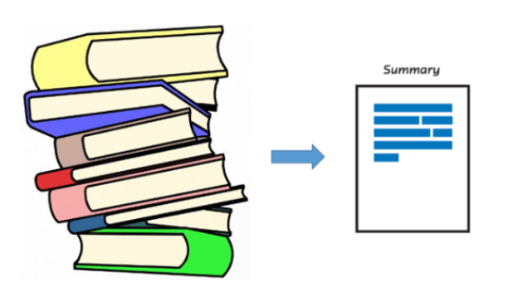
Applications of Transformers (NLP)
Text Summarization / Text Paraphrasing / GEC
Text Summarizer tools: Summarize Bot, Resoomer, SMMRY
Text Paraphrasing tools – Quillbot, Spinbot, Grammarly, GoParaphrase etc.
GEC (Grammatical Error Checker) - Grammarly
Notes:
This slide highlights key applications of Transformers in NLP: Text Summarization, Text Paraphrasing, and Grammatical Error Checking (GEC). Below is a detailed explanation of each:
1. Text Summarization
Definition:
Text summarization is the process of condensing a larger body of text into a shorter version while retaining its core ideas and meaning.
Types:
Extractive Summarization: Selects key sentences or phrases directly from the source text.
Abstractive Summarization: Generates new sentences that paraphrase the source text.
Role of Transformers:
Advanced Context Understanding:
Transformers, like T5 (Text-to-Text Transfer Transformer) and BART (Bidirectional and Auto-Regressive Transformers), analyze entire documents using self-attention mechanisms to generate meaningful summaries.
Long-Document Handling:
Models like Longformer specialize in summarizing lengthy documents by processing long input sequences efficiently.
Example Use Cases:
Summarizing research papers or technical reports.
Creating concise news highlights.
Summarizing meeting transcripts for corporate use.
Popular Tools:
Summarize Bot: A tool that uses AI to extract key ideas from long texts.
Resoomer and SMMRY: Provide automated summarization for various types of content.
2. Text Paraphrasing
Definition:
Text paraphrasing involves rephrasing a given piece of text while preserving its meaning and avoiding redundancy.
Role of Transformers:
Synonym and Structure Replacement:
Transformers identify synonyms and restructure sentences to maintain coherence while rephrasing.
Context Awareness:
Models like T5 and Parrot Paraphraser excel at generating grammatically correct and contextually appropriate paraphrased text.
Example Use Cases:
Generating alternative phrasings for creative writing.
Rewriting content to avoid plagiarism.
Simplifying complex sentences for readability.
Popular Tools:
Quillbot: A widely used tool for rephrasing sentences.
Spinbot, Grammarly, and GoParaphrase: Automate paraphrasing tasks with varying levels of control and customization.
3. Grammatical Error Checking (GEC)
Definition:
GEC involves identifying and correcting grammatical, spelling, and punctuation errors in text.
Role of Transformers:
Error Detection and Correction:
Models like Grammarly’s Transformer-based system or GECToR identify errors using self-attention and context analysis, then suggest corrections.
Context-Sensitive Corrections:
Transformers ensure grammatical corrections align with the sentence’s context, avoiding incorrect fixes.
Example Use Cases:
Academic proofreading.
Business communications to ensure professionalism.
Improving content quality for blogs or articles.
Popular Tools:
Grammarly: A leading platform for GEC, utilizing transformer models for robust error detection and correction.
Illustration on the Slide
The slide visually represents a stack of books being condensed into a shorter document labeled "Summary," symbolizing Text Summarization.
Associated tools like Summarize Bot, Quillbot, and Grammarly are listed to show real-world applications.
Advantages of Transformers in These Applications
Accuracy: High precision in summarizing, paraphrasing, and correcting errors due to context understanding.
Efficiency: Automates time-consuming tasks like summarization and proofreading.
Scalability: Capable of handling large volumes of data across different domains.
Real-World Impact
Time-Saving:
Automates summarization, paraphrasing, and proofreading, saving time for professionals and students.
Enhanced Communication:
Improves content quality for blogs, emails, and reports.
Educational Accessibility:
Simplifies complex material for learners by summarizing or paraphrasing in simpler language.
Transformers have elevated NLP applications like summarization, paraphrasing, and grammatical error checking, making them indispensable in modern content creation and management.

Slide 49
Practical NLP with Transformers

Slide 50
NLP Task 1 -> Sentiment Analysis
[Comes under “Task Classification” category in HuggingFace]
Usage Example
from transformers import pipeline
classifier = pipeline('sentiment-analysis', model='distilbert-base-uncased-finetuned-sst-2-english')
result = classifier("I love this movie!")
print(result)
Here “Pipeline” is the high level API
Try it out in Google Colab!
Change “Runtime Type” to “T4 GPU” if required
Notes:
This slide demonstrates an NLP Task: Sentiment Analysis using the Hugging Face Transformers library. Below is a detailed explanation of the concepts and code:
Sentiment Analysis
Definition:
Sentiment Analysis involves determining the emotional tone behind a text (e.g., positive, negative, or neutral sentiment).
It is a subset of text classification tasks in NLP.
Example Application:
Analyzing user feedback (e.g., "I love this movie!") to classify the sentiment as positive.
Used in applications such as customer review analysis, social media sentiment tracking, and feedback analysis.
How It Works
Sentiment analysis uses transformer-based models like DistilBERT, a lightweight version of BERT, which is fine-tuned for specific tasks like sentiment classification.
The model processes the input text, tokenizes it, and predicts the sentiment label.
Code Walkthrough
Importing the Hugging Face Pipeline:
python
Copy code
from transformers import pipeline
Hugging Face provides a high-level pipeline API that simplifies the use of pre-trained transformer models for various tasks, including sentiment analysis.
Loading the Sentiment Analysis Pipeline:
python
Copy code
classifier = pipeline('sentiment-analysis', model='distilbert-base-uncased-finetuned-sst-2-english')
Task: 'sentiment-analysis' specifies the desired NLP task.
Model: 'distilbert-base-uncased-finetuned-sst-2-english' is a pre-trained model fine-tuned on the Stanford Sentiment Treebank (SST-2) dataset for sentiment analysis in English.
DistilBERT:
A smaller, faster, and more efficient version of BERT, retaining 97% of BERT's performance.
Classifying Sentiment:
python
Copy code
result = classifier("I love this movie!")
Input: The sentence "I love this movie!" is fed into the classifier.
Output: The model predicts the sentiment label (e.g., 'POSITIVE') along with the confidence score.
Displaying the Result:
python
Copy code
print(result)
Example Output:python
Copy code
[{'label': 'POSITIVE', 'score': 0.99}]
Label: Sentiment classification (e.g., 'POSITIVE' or 'NEGATIVE').
Score: Confidence level of the prediction.
Try it in Google Colab
The slide encourages running the code in Google Colab for hands-on experimentation:
Change Runtime Type: Switch to T4 GPU for faster execution, especially when dealing with large datasets or models.
Google Colab provides a free cloud-based platform with pre-installed libraries like Hugging Face.
Advantages of Using Hugging Face Pipeline
Ease of Use:
The pipeline API abstracts complex model loading and preprocessing steps.
Pre-Trained Models:
Leverages state-of-the-art models without needing to train from scratch.
Flexibility:
Supports multiple NLP tasks, including text classification, translation, and summarization.
Applications of Sentiment Analysis
Customer Feedback Analysis:
Assessing customer opinions about products or services.
Social Media Monitoring:
Tracking public sentiment about brands or events.
Market Research:
Gauging sentiment trends to inform business strategies.
Why Use DistilBERT for Sentiment Analysis?
Efficiency: Smaller and faster than BERT, ideal for real-time applications.
Accuracy: Maintains high accuracy while being lightweight.
Pre-Trained Availability: Fine-tuned on datasets like SST-2 ensures readiness for immediate use.
This slide provides a practical introduction to using transformers for sentiment analysis, highlighting the simplicity and effectiveness of the Hugging Face pipeline API.

Slide 51
NLP Task 2 -> Language Translation
Reference - https://huggingface.co/Helsinki-NLP/opus-mt-en-hi
[Read the Model Card; Go to -> “Use this Model -> Transformers” and view code]
Try it out in Google Colab!
Notes:
This slide introduces NLP Task 2: Language Translation using Transformers from the Hugging Face library, with a focus on implementing translation models in Python. Below is a detailed explanation of the task and its implementation:
Language Translation
Definition:
Language Translation is the process of converting text from one natural language (source) to another (target) while preserving meaning and grammatical correctness.
Example: Translating "Hello, how are you?" (English) to "नमस्ते, आप कैसे हैं?" (Hindi).
Model Reference
The slide references the Helsinki-NLP/opus-mt-en-hi model available on the Hugging Face platform:
Helsinki-NLP:
A collection of transformer-based models trained for language translation using the OPUS dataset.
The opus-mt-en-hi model translates English to Hindi.
Accessing the Model:
The model card on Hugging Face provides detailed information about the model, datasets used, and implementation examples.
Follow the path: "Use this Model -> Transformers" to view example code snippets.
How to Use in Code
Step 1: Import Required Libraries
python
Copy code
from transformers import pipeline
Hugging Face provides an easy-to-use pipeline API for translation tasks.
Step 2: Initialize the Translation Pipeline
python
Copy code
translator = pipeline('translation_en_to_hi', model='Helsinki-NLP/opus-mt-en-hi')
Task: translation_en_to_hi specifies English-to-Hindi translation.
Model: The pre-trained model Helsinki-NLP/opus-mt-en-hi is loaded.
Step 3: Translate Text
python
Copy code
result = translator("Hello, how are you?") print(result)
Input: The English text to be translated.
Output: The translated text in Hindi, along with confidence scores.
Example Output:
python
Copy code
[{'translation_text': 'नमस्ते, आप कैसे हैं?'}]
Try it in Google Colab
Why Use Google Colab?
Colab provides free cloud-based resources, including GPUs, to run large models efficiently.
Steps:
Open Google Colab.
Change the Runtime Type to include a GPU for faster model inference (Navigate to Runtime > Change Runtime Type > Hardware Accelerator > GPU).
Copy and paste the code snippet to execute the translation task.
Advantages of Using Hugging Face for Translation
Pre-Trained Models:
No need to train models from scratch; use pre-trained ones for quick results.
Ease of Implementation:
The pipeline API abstracts preprocessing and postprocessing steps, simplifying the process.
Multilingual Support:
Models support translations across a wide range of language pairs.
Applications of Language Translation
Cross-Cultural Communication:
Enables communication across different languages in business and personal contexts.
Content Localization:
Translates websites, apps, and educational materials for global accessibility.
Tourism and Travel:
Provides real-time translation for travelers.
Healthcare:
Assists in translating medical information for patients and professionals.
Why Use Helsinki-NLP?
Efficient Models:
Lightweight and optimized for translation tasks.
Large Dataset Training:
Trained on diverse datasets, ensuring high-quality translations.
Open Access:
Freely available on the Hugging Face hub.
This slide provides a practical starting point for implementing language translation using transformer models, highlighting the ease and power of pre-trained tools like Hugging Face.

Slide 52
NLP Task 3 -> Question Answering
Reference - https://huggingface.co/distilbert/distilbert-base-uncased-distilled-squad
Try it out in Google Colab!

Slide 53
Computer Vision APIs

Slide 54

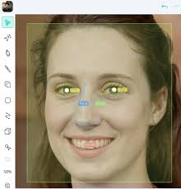
Computer Vision
Computer vision is a field that uses algorithms to process images and videos to perform tasks such as
Object detection
Locating and identifying objects in an image or video. This is used in many applications, including surveillance, robotics, image and video analysis.
Face recognition
A widely used application of computer vision, face recognition is used to unlock devices and identify security threats.
Notes:
This slide provides an introduction to Computer Vision and highlights two major tasks: Object Detection and Face Recognition. Here is a detailed explanation:
What is Computer Vision?
Definition: Computer vision is a field of artificial intelligence (AI) focused on enabling machines to interpret and process visual data (images and videos) to mimic human vision.
Goal: Extract meaningful information from visual inputs to perform specific tasks.
Applications: It is widely used in areas such as healthcare, surveillance, robotics, e-commerce, and entertainment.
1. Object Detection
Definition:
Object detection involves locating and identifying objects within an image or video.
Key Capabilities:
Identifying multiple objects in a single frame.
Drawing bounding boxes around detected objects to mark their location.
How It Works:
Machine Learning Models:
Object detection relies on pre-trained deep learning models such as YOLO (You Only Look Once), Faster R-CNN, and SSD (Single Shot MultiBox Detector).
Key Steps:
Feature Extraction: The model analyzes image features (e.g., edges, textures).
Object Classification: Determines the type of object detected.
Localization: Provides the object's coordinates in the image.
Applications:
Surveillance:
Detecting unusual activities or identifying specific objects (e.g., weapons).
Robotics:
Enabling robots to navigate by recognizing obstacles.
Image and Video Analysis:
Identifying objects in video streams for automated tagging.
Illustration on the Slide:
The slide includes an example of an apple with a bounding box drawn around it, representing how object detection identifies and localizes objects in an image.
2. Face Recognition
Definition:
Face recognition is a specific application of computer vision that identifies or verifies individuals based on their facial features.
Steps:
Face Detection: Identifying faces within an image.
Feature Extraction: Analyzing key facial features (e.g., eyes, nose, and mouth).
Recognition: Comparing extracted features against a database to identify the person.
How It Works:
Deep Learning Models:
Models like FaceNet and Dlib utilize convolutional neural networks (CNNs) to analyze facial patterns.
Techniques:
Facial landmarks (e.g., eyes, nose) are detected and used for matching.
Feature vectors are created to uniquely identify individuals.
Applications:
Unlocking Devices:
Smartphones use facial recognition for authentication.
Security:
Identifying individuals in surveillance systems.
Healthcare:
Monitoring patient emotions or behaviors.
Illustration on the Slide:
The slide shows a face with key landmarks highlighted, demonstrating how facial features are detected and analyzed.
Benefits of Computer Vision
Efficiency:
Automates tasks that are time-consuming for humans, such as scanning images for specific objects.
Accuracy:
Modern AI models achieve high precision in identifying and categorizing objects and faces.
Real-Time Processing:
Enables applications like live surveillance and self-driving cars.
Real-World Use Cases
Healthcare:
Detecting abnormalities in medical scans (e.g., tumors in MRIs).
Retail:
Analyzing customer behavior through video feeds to optimize store layouts.
Autonomous Vehicles:
Identifying pedestrians, vehicles, and road signs to navigate safely.
Conclusion
Computer vision, powered by deep learning models, has transformed industries by automating visual tasks with remarkable accuracy and speed. Object detection and face recognition are foundational tasks that enable applications ranging from security to everyday conveniences like unlocking phones.

Slide 55
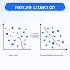
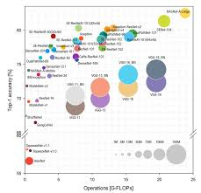
Computer Vision
Computer vision is a field that uses algorithms to process images and videos to perform tasks such as
Feature extraction
An essential part of applications that require computer vision to recognize objects in an image.
Image classification
A fundamental task in computer vision, image classification identifies the class an input image falls under.
Notes:
This slide provides an overview of Computer Vision and emphasizes two specific tasks: Feature Extraction and Image Classification. Below is a detailed explanation:
What is Computer Vision?
Definition: Computer Vision is a domain of Artificial Intelligence (AI) that enables computers to process, interpret, and analyze visual data from the real world, such as images and videos.
Objective: Automate tasks that require human visual perception.
Applications: It spans a wide range of industries, including healthcare, autonomous vehicles, security, retail, and more.
1. Feature Extraction
Definition:
Feature extraction is the process of identifying key characteristics or patterns within an image to simplify and interpret the visual content.
Role:
Reduces the complexity of image data by converting it into a manageable set of attributes (e.g., edges, shapes, colors, or textures).
Provides a foundation for more complex computer vision tasks like object detection and image recognition.
How It Works:
Raw Data:
Input visual data is processed to identify distinct features (e.g., gradients, contours).
Techniques:
Classical Methods:
Algorithms like SIFT (Scale-Invariant Feature Transform) or HOG (Histogram of Oriented Gradients) extract low-level features.
Deep Learning:
Convolutional Neural Networks (CNNs) automatically learn and extract hierarchical features directly from images.
Applications:
Object Recognition:
Identifying objects within an image (e.g., detecting a car in a traffic camera feed).
Image Segmentation:
Dividing an image into meaningful segments (e.g., distinguishing between the sky and buildings in a landscape photo).
Dimensionality Reduction:
Reducing high-dimensional image data for faster processing.
Illustration on the Slide:
A diagram showing raw data being processed into distinct features, highlighting how patterns are extracted for further tasks.
2. Image Classification
Definition:
Image classification involves assigning a label or class to an input image based on its content.
Example:
Classifying an image of a dog as belonging to the "dog" category.
How It Works:
Training Phase:
The model is trained on labeled datasets to learn patterns associated with different classes (e.g., CIFAR-10, ImageNet).
Inference Phase:
The model predicts the class of new, unseen images by analyzing their features.
Deep Learning Models:
CNN architectures like AlexNet, ResNet, and VGG are commonly used for classification tasks.
Applications:
Healthcare:
Diagnosing diseases from medical images (e.g., identifying tumors in X-rays).
Retail:
Classifying products based on their images for inventory management.
Autonomous Vehicles:
Classifying objects such as pedestrians, vehicles, and traffic signs for safe navigation.
Illustration on the Slide:
A scatter plot and classification results, showcasing how data points (images) are categorized into different classes based on extracted features.
Key Differences Between Feature Extraction and Image Classification
Feature ExtractionImage ClassificationFocuses on identifying patternsFocuses on labeling the imagePreprocessing step for tasksEnd goal in some applicationsCan be manual or automatedRelies on extracted featuresAdvantages of Computer Vision in These Tasks
Feature Extraction:
Simplifies complex visual data for downstream tasks.
Reduces computational requirements.
Image Classification:
Enables automation in tasks requiring categorization.
Improves accuracy and efficiency in real-world applications.
Real-World Use Cases
E-commerce:
Classifying product images for search optimization.
Security:
Monitoring video feeds to detect and classify suspicious activities.
Manufacturing:
Identifying defective products in production lines.
Feature extraction and image classification are foundational tasks in computer vision, enabling more complex AI-driven solutions across industries.

Slide 56
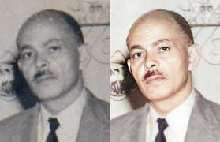
Computer Vision
Computer vision is a field that uses algorithms to process images and videos to perform tasks such as
Image restoration
An important task in computer vision, image restoration can include image in paintings, image deblurring, pixel interpolation, and image denoising
Object Tracking is a continuous CV task that aims to track a specific object or multiple objects over a sequence of frames
Scene reconstruction is the process of reconstructing a 3D digital version of a real-world object from pictures or scans of the object
Notes:
This slide elaborates on Computer Vision applications, focusing on Image Restoration, Object Tracking, and Scene Reconstruction. Below is a detailed explanation:
What is Computer Vision?
Definition: Computer vision enables machines to interpret and process visual data from the real world (images and videos) to perform specific tasks.
Objective: Automate tasks that typically require human vision and understanding.
Applications: It spans various industries such as healthcare, surveillance, entertainment, robotics, and autonomous vehicles.
1. Image Restoration
Definition:
Image restoration focuses on enhancing or recovering degraded images to improve their quality and usability.
Techniques:
Image Inpainting:
Filling in missing or damaged parts of an image.
Example: Restoring old, scratched photos.
Image Deblurring:
Removing motion blur or out-of-focus blur to produce a sharper image.
Example: Enhancing blurry surveillance footage.
Pixel Interpolation:
Estimating missing pixel values in an image to enhance resolution.
Example: Upscaling a low-resolution image for display on high-resolution screens.
Image Denoising:
Reducing noise (random variations in brightness or color) from an image.
Example: Cleaning up noisy images captured in low light.
Applications:
Photography:
Restoring old or damaged photographs.
Healthcare:
Enhancing medical imaging for accurate diagnosis.
Surveillance:
Clarifying low-quality security footage.
Illustration on the Slide:
A degraded photo (left) is shown restored (right), demonstrating the improvement in quality through restoration techniques.
2. Object Tracking
Definition:
Object tracking involves continuously monitoring and locating a specific object or multiple objects across a sequence of frames in a video.
How It Works:
Initialization:
Detecting the object(s) of interest in the first frame.
Tracking:
Monitoring the object's movement across subsequent frames using algorithms.
Techniques:
Feature Matching:
Using key features (e.g., edges, textures) to track objects.
Deep Learning Models:
Leveraging algorithms like SORT (Simple Online and Realtime Tracking) or DeepSORT for enhanced accuracy.
Applications:
Surveillance:
Monitoring and tracking people or vehicles.
Sports Analytics:
Tracking players or balls in real time.
Autonomous Vehicles:
Tracking nearby vehicles, pedestrians, or obstacles for safe navigation.
3. Scene Reconstruction
Definition:
Scene reconstruction is the process of creating a 3D digital representation of a real-world object or scene using multiple images or scans.
Steps:
Data Collection:
Capturing images or scans of the object from various angles.
Feature Extraction:
Identifying key points in the images to align and reconstruct the scene.
3D Modeling:
Using algorithms to generate a 3D model from the collected data.
Applications:
Architecture and Real Estate:
Creating 3D walkthroughs of buildings or interiors.
Gaming and Animation:
Generating realistic 3D environments for games or movies.
Healthcare:
Reconstructing organs or body parts for medical analysis.
Illustrations on the Slide
Image Restoration:
Shows a before-and-after comparison of an old photo, illustrating how restoration improves quality.
Object Tracking:
Highlights the process of identifying and tracking objects across video frames.
Scene Reconstruction:
Refers to the creation of a 3D version of objects or environments.
Advantages of These Applications
Improved Visual Quality:
Image restoration enhances usability and aesthetics.
Real-Time Monitoring:
Object tracking enables dynamic analysis for surveillance and safety.
Enhanced Visualization:
Scene reconstruction provides detailed 3D representations for better understanding and interaction.
Real-World Use Cases
Image Restoration:
Used in museums to restore historical photographs and artworks.
Object Tracking:
Deployed in traffic management systems to track vehicles.
Scene Reconstruction:
Widely used in archaeological research to digitally recreate ancient artifacts or ruins.
These tasks showcase the versatility and power of computer vision, addressing a broad spectrum of real-world challenges and applications.

Slide 57
CV Task -> Image Classification
Model - facebook/deit-base-distilled-patch16-224
Code
from transformers import pipeline
# Load the image classification pipeline
image_classifier = pipeline("image-classification", model="facebook/deit-base-distilled-patch16-224")
# Use a new image URL (make sure it's a valid and accessible image URL)
url = "https://upload.wikimedia.org/wikipedia/commons/9/9a/Pug_600.jpg"
# Perform image classification using the URL directly
result = image_classifier(url)
# Print the result
print(result)
Notes:
This slide illustrates an example of performing Image Classification using a transformer-based model provided by Hugging Face. Below is a detailed breakdown of the task, code, and its execution.
What is Image Classification?
Definition: Image classification is the process of identifying the class or category of an input image.
Example:
Identifying a picture of a dog as belonging to the "dog" category.
Model Used
Model Name: facebook/deit-base-distilled-patch16-224
DeiT (Data-efficient Image Transformer):
A vision transformer (ViT) model optimized for efficient image classification.
"Distilled" version uses knowledge distillation, which improves model performance by training it to mimic a larger teacher model.
Code Walkthrough
1. Import Required Library
python
Copy code
from transformers import pipeline
Hugging Face provides the pipeline API, which simplifies model usage for tasks like image classification.
2. Load the Image Classification Pipeline
python
Copy code
image_classifier = pipeline("image-classification", model="facebook/deit-base-distilled-patch16-224")
Pipeline Type: "image-classification" specifies the task type.
Model: The facebook/deit-base-distilled-patch16-224 model is loaded for classifying images.
3. Use an Image URL
python
Copy code
url = "https://upload.wikimedia.org/wikipedia/commons/9/9a/Pug_600.jpg"
Input: An online image URL (e.g., a picture of a pug).
Ensure the URL is valid and publicly accessible.
4. Perform Image Classification
python
Copy code
result = image_classifier(url)
The image from the provided URL is processed by the model to predict the class.
5. Print the Result
python
Copy code
print(result)
The predicted class label and confidence score are displayed as the output.
Example Output:python
Copy code
[{'label': 'pug', 'score': 0.99}]
Label: The class the image belongs to (e.g., "pug").
Score: The model's confidence in the prediction.
Try It Out
The slide encourages users to execute the code in Google Colab or any Python environment with internet access and the Hugging Face library installed.
Ensure proper runtime setup (e.g., enable GPU in Colab for faster processing).
How the Model Works
Transformer Architecture:
Processes image patches using attention mechanisms to extract meaningful patterns.
Pre-Trained Capability:
The model is trained on large datasets (like ImageNet) and fine-tuned for specific image classification tasks.
Applications of Image Classification
Healthcare:
Diagnosing diseases from medical images (e.g., identifying tumors in X-rays).
E-commerce:
Automatically tagging product images.
Autonomous Vehicles:
Identifying pedestrians, vehicles, and road signs.
Security:
Detecting specific objects or individuals in surveillance footage.
Advantages of Using Hugging Face for Image Classification
Ease of Use:
The pipeline API abstracts complex steps like preprocessing and postprocessing.
Pre-Trained Models:
Eliminates the need to train models from scratch.
Flexibility:
Supports various image classification tasks with minimal setup.
Conclusion
This code demonstrates how to leverage Hugging Face's transformer models for accurate and efficient image classification tasks, providing an intuitive starting point for applications in various domains.

Slide 58
Speech Recognition APIs
[Self Study]

Slide 59
Thank You!

Slide 60
Appendix

Slide 61
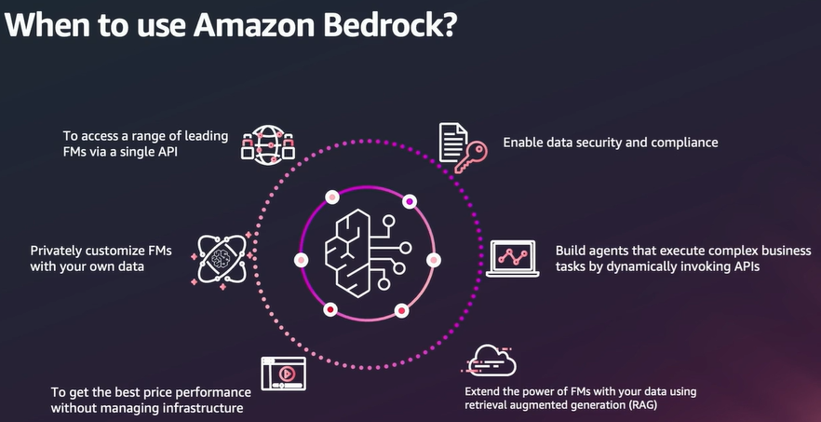
Amazon BedRock
Ref: Adapted from 'AWS Innovate Conference, 2024', Presentation by Melwin Pais, Senior Solution Architect, AWS
Notes:
This slide introduces Amazon Bedrock, a managed service provided by AWS that allows developers to build and scale generative AI applications using foundation models (FMs). Below is a detailed explanation of the use cases and benefits highlighted in the slide.
What is Amazon Bedrock?
Amazon Bedrock enables users to access foundation models (FMs) from multiple providers through a single API.
It abstracts the complexities of managing infrastructure, model training, and fine-tuning, allowing users to focus on building applications.
Foundation Models (FMs): Large pre-trained models that can perform a variety of tasks, such as text generation, summarization, classification, and more.
When to Use Amazon Bedrock?
1. Accessing Leading Foundation Models (FMs) via a Single API
Benefit: Simplifies the integration of various pre-trained FMs (from providers like AWS, Hugging Face, and others) into applications.
Use Case: Developers can experiment with multiple models without managing complex APIs for each.
2. Customizing Foundation Models with Your Data
Benefit: Fine-tune pre-trained models using proprietary or domain-specific data without exposing the data to external environments.
Use Case: Organizations can build customized chatbots, recommendation systems, or summarization tools tailored to their business needs.
3. Enabling Data Security and Compliance
Benefit: Provides robust data privacy, encryption, and compliance with industry standards (e.g., GDPR, HIPAA).
Use Case: Financial and healthcare organizations can adopt FMs securely while adhering to regulatory requirements.
4. Building Agents to Automate Complex Business Tasks
Benefit: Enables developers to create intelligent agents that can dynamically invoke APIs and perform multi-step workflows.
Use Case: Automating customer support, supply chain management, or internal IT operations.
5. Extending FMs with Retrieval-Augmented Generation (RAG)
Benefit: Combines the capabilities of foundation models with retrieval systems to provide more accurate and contextually relevant responses.
Use Case: Knowledge management systems that fetch real-time information from enterprise databases.
6. Achieving Cost-Efficiency Without Managing Infrastructure
Benefit: Removes the burden of provisioning, scaling, and maintaining infrastructure for running FMs, optimizing costs.
Use Case: Startups and small businesses can leverage FMs without investing in large-scale infrastructure.
Advantages of Amazon Bedrock
Scalability:
Dynamically scales resources based on workload, ensuring seamless performance for applications of any size.
Flexibility:
Supports multiple foundation models, giving developers the freedom to choose models based on task requirements.
Ease of Use:
Single API access reduces development time and complexity.
Data Privacy:
Securely integrates enterprise data without exposing it externally.
Real-World Use Cases
Customer Support:
Build intelligent chatbots that handle customer queries, escalate issues, and provide personalized responses.
Content Creation:
Automate the generation of marketing materials, product descriptions, or technical documentation.
Healthcare:
Analyze patient data and generate medical reports or summaries.
Financial Services:
Summarize legal documents, process compliance reports, or generate investment insights.
Conclusion
Amazon Bedrock is an ideal platform for organizations looking to integrate and scale generative AI solutions while ensuring flexibility, security, and cost efficiency. It empowers businesses to adopt cutting-edge AI technologies without the operational complexities of managing models and infrastructure.

Slide 62
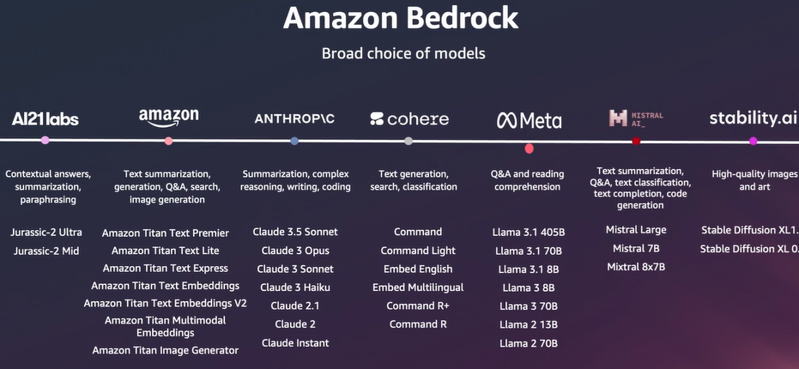
Amazon BedRock – Choice of Models
Ref: Adapted from 'AWS Innovate Conference, 2024', Presentation by Melwin Pais, Senior Solution Architect, AWS
Notes:
This slide provides an overview of the diverse foundation models (FMs) available through Amazon Bedrock. These models come from various leading AI providers and cater to a wide range of AI applications. Here's a detailed explanation:
What is Amazon Bedrock – Choice of Models?
Amazon Bedrock offers a variety of pre-trained and fine-tunable foundation models from multiple providers, allowing businesses to select the best model for their specific use cases. It simplifies access to these models via a unified API, eliminating the need to manage separate infrastructures for different providers.
Model Providers and Their Capabilities
1. AI21 Labs
Models:
Jurassic-2 Ultra
Jurassic-2 Mid
Capabilities:
Contextual Answers: Provides contextually accurate responses to queries.
Summarization: Condenses large texts into shorter, meaningful summaries.
Paraphrasing: Rewrites content while retaining the original meaning.
Applications:
Content creation, academic tools, and conversational AI.
2. Amazon
Models:
Amazon Titan Text Premier
Amazon Titan Text Lite
Amazon Titan Text Express
Amazon Titan Text Embeddings
Amazon Titan Image Generator
Capabilities:
Text Summarization and Generation: Generates human-like text and concise summaries.
Image Generation: Creates high-quality images based on text inputs.
Multimodal Embeddings: Combines text and image understanding.
Applications:
Search engine optimization, personalized recommendations, and digital content generation.
3. Anthropic
Models:
Claude 3.5 Sonnet
Claude 3 Opus
Claude 2.1
Claude Instant
Capabilities:
Complex Reasoning: Handles logical tasks like summarizing, coding, and advanced Q&A.
Writing Assistance: Excels in creative and technical writing tasks.
Applications:
Chatbots, legal document review, and educational tools.
4. Cohere
Models:
Command
Command Light
Command R+
Embed Multilingual
Capabilities:
Text Generation and Classification: Generates and classifies text efficiently.
Search: Enhances information retrieval capabilities with context-aware embeddings.
Applications:
Customer service, sentiment analysis, and document indexing.
5. Meta
Models:
Llama 3.1 (405B, 70B, 8B)
Llama 2 (13B, 70B)
Capabilities:
Q&A: Answers questions with high accuracy.
Reading Comprehension: Understands and processes large documents effectively.
Applications:
Knowledge management, research tools, and virtual assistants.
6. Mistral AI
Models:
Mistral Large
Mistral 7B
Mixtral 8x7B
Capabilities:
Code Generation: Generates and completes code snippets.
Text Classification: Categorizes text into predefined labels.
Text Summarization and Q&A: Processes large volumes of text for summarization or information extraction.
Applications:
Developer tools, software debugging, and enterprise search.
7. Stability.ai
Models:
Stable Diffusion XL1.1
Stable Diffusion XL 0.9
Capabilities:
High-Quality Image Generation: Creates realistic and creative images based on textual descriptions.
Applications:
Graphic design, marketing, and art creation.
Why Use Amazon Bedrock's Diverse Model Selection?
Flexibility:
Access to models from multiple providers lets businesses choose the most suitable FM for their needs.
Ease of Integration:
Unified API eliminates the complexity of managing individual models and infrastructures.
Customization:
Fine-tune models with proprietary data for domain-specific tasks.
Scalability:
Models scale with workloads, ensuring efficient performance.
Real-World Use Cases
E-commerce:
Product categorization and customer support chatbots.
Healthcare:
Medical report summarization and patient interaction tools.
Finance:
Risk analysis, fraud detection, and market predictions.
Creative Industries:
High-quality image generation and text-based art creation.
Amazon Bedrock provides a robust platform for leveraging foundation models from the world's leading AI providers, enabling businesses to build scalable, secure, and impactful AI solutions.

Slide 63
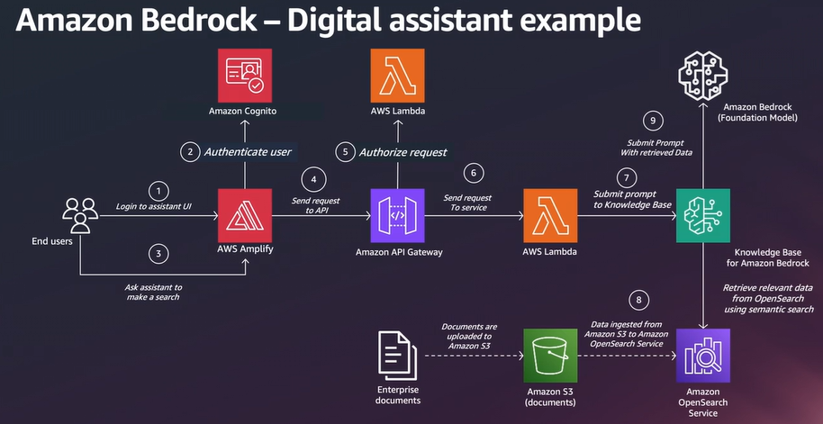
Amazon BedRock – Use Case
Ref: Adapted from 'AWS Innovate Conference, 2024', Presentation by Melwin Pais, Senior Solution Architect, AWS
Notes:
This slide illustrates a use case for Amazon Bedrock in building a Digital Assistant, integrating various AWS services to deliver seamless functionality. Below is a detailed explanation of the flow and components involved:
Use Case: Digital Assistant Example
This example demonstrates how Amazon Bedrock integrates with AWS services to create an intelligent digital assistant capable of retrieving information, responding to user queries, and leveraging foundation models (FMs) for advanced tasks.
Workflow Explanation
Step 1: User Login
Component: End Users & AWS Amplify
Action: Users log in to the assistant's user interface (UI) hosted using AWS Amplify.
Purpose: AWS Amplify provides a scalable front-end framework for building and hosting the assistant’s web or mobile interface.
Step 2: Authenticate User
Component: Amazon Cognito
Action: The login request is authenticated via Amazon Cognito, which manages user identities and access control.
Purpose: Ensures that only authorized users can access the assistant.
Step 3: User Query
Component: AWS Amplify
Action: Users interact with the assistant by entering a query or task request, such as retrieving information or summarizing a document.
Step 4: API Request
Component: Amazon API Gateway
Action: Amplify sends the user’s request to the API Gateway, which routes it to the appropriate backend service.
Purpose: Acts as a bridge between the front end and the backend infrastructure.
Step 5: Authorize Request
Component: AWS Lambda
Action: A Lambda function validates the API request and ensures that it adheres to security and authorization protocols.
Purpose: Adds a layer of security and request validation.
Step 6: Route to Service
Component: AWS Lambda
Action: The validated request is processed and routed to the knowledge base or Amazon Bedrock for further handling.
Purpose: Facilitates dynamic decision-making based on the type of user query.
Step 7: Knowledge Base Query
Components:
Amazon OpenSearch Service
Amazon S3
Action:
The query is sent to a knowledge base integrated with OpenSearch for semantic search.
Relevant data is retrieved from indexed documents stored in Amazon S3.
Purpose: Enables the assistant to provide contextually accurate responses by searching enterprise knowledge bases.
Step 8: Data Retrieval
Components: Amazon S3 and OpenSearch
Action: Documents and data ingested into OpenSearch are retrieved and prepared for further processing.
Purpose: Ensures the assistant has access to the most relevant and updated information.
Step 9: Submit Prompt to Amazon Bedrock
Component: Amazon Bedrock
Action:
The retrieved data, along with the user’s prompt, is processed using a foundation model via Amazon Bedrock.
The model generates the response based on the data and query.
Purpose: Leverages generative AI for complex tasks like summarization, contextual Q&A, or content generation.
Foundation Model Capabilities
Q&A: Respond to user queries with accurate and context-aware answers.
Summarization: Condense large documents into concise summaries.
Generation: Produce human-like text or structured outputs tailored to the user’s request.
Advantages of This Use Case
Scalability:
The serverless architecture scales dynamically based on user interactions.
Security:
Ensures secure access through Amazon Cognito and API Gateway.
Seamless Integration:
Combines multiple AWS services to create a robust digital assistant pipeline.
Intelligent Responses:
Uses advanced FMs via Amazon Bedrock for enhanced accuracy and contextual understanding.
Applications of the Digital Assistant
Enterprise Knowledge Management:
Assists employees in retrieving information from internal databases.
Customer Support:
Handles FAQs, ticket generation, and troubleshooting queries.
Education:
Acts as a teaching assistant by summarizing content and answering student queries.
Healthcare:
Retrieves medical knowledge or assists in creating reports.
Conclusion
This use case highlights how Amazon Bedrock integrates with the AWS ecosystem to build intelligent, scalable, and secure digital assistants, leveraging the power of foundation models and cloud-based infrastructure.

